Slide 1

Assessing Fine Arts Instruction: Classroom “Look Fors” for Administrators
Ken Skrzesz, Coordinator of Fine Arts
Kenneth.skrzesz@maryland.gov

Slide 2
Today’s Structure and Objectives
Share Philosophical Ideas
Share Some New Thoughts About Arts Education
Discuss Your Observations

Slide 3
Overarching Concepts

Slide 4
Models of the Creative Process
4 Models of Phases – Non-Linear
Model 1 Petty | Model 2 Taylor | Model 3 Graham | Model 4 Wallas
Inspiration | Preparation | Intent | Preparation
Clarification | Incubation | Explore/Gather | Incubation
Evaluation | Insight | Connect/Experiment | Illumination
Distillation | Evaluation | Create | Implementation
Incubation | Elaboration | Evaluate
Perspiration

Slide 5
The Creative Classroom
FOCUS: Opening exercise (bringing students into a creative environment)
DETAIL: Warm-up and introduce the topics to be covered (specifics that engage mind and body)
DISCOVERY: Perform activities of creativity (the freedom to interpret)
APPLICATION: Create work (technique meets product)
PRESENTATION: Share work (synthesis of new information)
LINK: Connect what was accomplished to “where we go from here?”

Slide 6
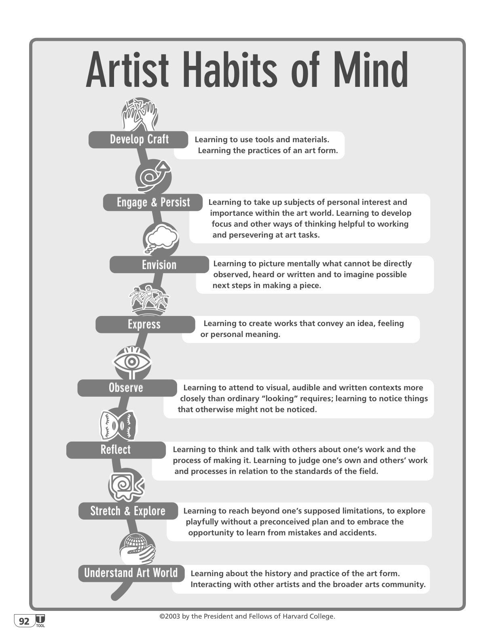

Slide 7
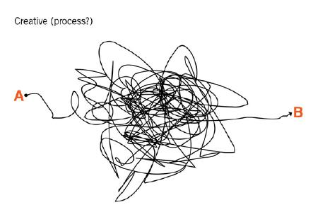


Guiding Premise for
Arts Education

Slide 8
What’s Happening in the Mess?
Explore an Open-Ended Question (Concept) in a Dependable Environment
Deepen Knowledge of Content through Authentic Application (Performance-Based Outcome)
Define Personal (Independent) and Collaborative Processes
Acquire 21st Century Skills
Build Skills and Techniques while Creating a Product
Develop Creative Habits Over Time and Through Planning

Slide 9
Philosophical Premise 1
Effective teachers are constantly asking 4 questions – all grades, all ability levels – in very subtle ways:
Who am I?
Who are my students?
What might they become?
What might we become together?
(Critical Pedagogy for MUED by Frank Abrahams)

Slide 10
Philosophical Premise 2
Students are constantly asking 4 questions – all grades, all ability levels – in very subtle ways:
Do you see me?
Do you hear me?
Do I matter?
Are you brave enough to share your process?

Slide 11
Speed adversely affects creativity and work:
“When creativity is under the gun, it usually ends up getting killed… Complex cognitive processing takes time, and, without some reasonable time for that processing, creativity is almost impossible.”
Harvard Business Review

Slide 12
Assessing the Creative Classroom and
Experiential Learning

Slide 13
Creative Classroom | Habit of Mind | MSDE Effective Lesson Framework | Danielson Domain | Marzano Design Questions and Domains
Focus - Entering the Environment | Observe Envision | Warm-Up, Activate Prior Knowledge (Could be Motivation or Management) | 1b: Knowledge of Learning Process 1e: Designing Coherent Instruction | DQ2 (2): Organizing Students to Interact with New Knowledge DQ3 (9): Reviewing Content
What Do You See?
A Set or Developing Warm-Up Activity Responses to Prior Knowledge Prompts

Slide 14
Creative Classroom | Habit of Mind | MSDE Effective Lesson Framework | Danielson Domain | Marzano Design Questions and Domains
Detail – Introduce Topics and Themes | Develop Craft | Objective and Purpose | 1c: Setting Instructional Outcomes 2b: Establishing a Culture for Learning 3a: Expectations for Learning | DQ1 (1): Providing Clear Learning Goals & Scales (Rubrics)
What Do You See?
Responses to Presented Thematic Concepts Technique-Building Activities in Response to a Presented or Researched Topic or Theme

Slide 15
Creative Classroom | Habit of Mind | MSDE Effective Lesson Framework | Danielson Domain | Marzano Design Questions and Domains
Discovery – Activities of Creativity | Stretch and Explore | Instructional Input (Instructional Strategies) | 1e: Lesson & Unit Structure 3a: Explanations of Content 3b: Questioning & Discussion Techniques 3c: Structure & Pacing | DQ2 (2-6): Previewing, Chunking, Processing, Elaborating New Content/ Information DQ5 (3-6): Response Rates, Pacing, Intensity, Enthusiasm
What Do You See?
Individual and/or Collaborative Responses to Thematic Concepts Teacher Facilitation of Developed Artistic Techniques to be Challenged, Improved and Utilized

Slide 16
Creative Classroom | Habit of Mind | MSDE Effective Lesson Framework | Danielson Domain | Marzano Design Questions and Domains
Application – Produce Work | Engage and Persist | Student Learning* (Curriculum Planning) | 3c: Engage Students in Learning 3c: Activities & Assignments 3c: Grouping of Students | DQ4 (16-17): Organize & Engage Students in Cognitively Complex Tasks DQ5 (1-9): Management & Instructional Activities to Engage Students
What Do You See?
Urgency Building Toward Production Artistic Techniques and Aesthetic Judgments Informing Decisions Ongoing Teacher and Student Assessment of Technique and Developing Product Teacher Facilitation of Time Management and Increasing Creative and Technical Prowess Teacher Prompted Metacognitive Check-Ins

Slide 17
Creative Classroom | Habit of Mind | MSDE Effective Lesson Framework | Danielson Domain | Marzano Design Questions and Domains
Presentation – Share Work | Express | Checking for Understanding (Management) Guided Practice (Curriculum Planning) | 3d: Monitoring Student Learning 3d: Feedback to Students 1e: Learning Activities & Instructional Groups 3d:Student Self-Assessment & Monitoring 3e: Teacher Flexibility & Responsiveness | DQ1 (2): Tracking Student Progress DQ9 (16-19): Asking Questions & Probing Incorrect Answers DQ3 (11): Using Homework DQ3 (12-13): Examining Similarities and Differences, Errors in Reasoning DQ3 (14): Practicing Skills, Strategies & Processes
What Do You See?
Synthesis of New Information Developing Products Reflecting Technique and Process Students Responding in a Safe Environment Teacher Facilitation of Presentation Environment by Modeling Feedback

Slide 18
Creative Classroom | Habit of Mind | MSDE Effective Lesson Framework | Danielson Domain | Marzano Design Questions and Domains
Link – What Happened and Where Do We Go From Here? | Reflect Understand the World | Closure (Instructional Strategies) Teacher Reflection (Curriculum Planning) | 1e: Lesson & Unit Structure 3c: Structure & Pacing 1e: Designing Coherent Instruction 4a: Reflecting on Teaching | Domain 2: Planning & Preparing Domain 3: Reflecting on Teaching
What Do You See?
The “Why” being Presented, Challenged and Discussed Teacher/Student Facilitation of Connections Beyond the Student and Classroom

Slide 19
Creative Process and 21st Century Skills
Benefits of the Creative Process: (General Research of Artist’s Process Statements and Task Force Report) | 21st Century Skills: (The Partnership for 21st Century Skills)
Metacognition, Creativity, Innovation, Imagination, Ideation | Think Creatively, Be Self-Directed Learners, Work Independently
Editing | Make Judgments and Decisions, Reason Effectively
Self-Efficacy | Adapt to Change, Be Flexible, Manage Goals and Times, Manage Projects
Critical Thinking, Critical Judgment, Problem Solving | Critical Thinking and Problem Solving
Concentration, Create Meaning, Understand Meaning, Inquiry, Research, Cultural Literacy, Understanding Other Subjects | Access, Evaluate, Use and Manage Information, Analyze Media
Perseverance, Sensory Perception | Act On Creative Ideas
Production, Motor and Technical Skills | Implement Innovations, Apply Technology Effectively Produce Results, Create Media Products
Communication, Collaboration, Teamwork, Empathy | Communicate Clearly, Interact Effectively with Others Work Effectively with Diverse Teams, Work Creatively with Others, Collaborate with Others

Slide 20
Creativity takes the raw data of the 5 senses and turns it into a unique creative expression. No one else is metabolizing the experience in the same way.
Deepak Chopra

Slide 21

Kenneth.skrzesz@maryland.gov

