Slide 1
PARCC Consortium
2010
Governing members: 11
2014
Governing members: 13
2015
Administering the test: 12 members
5m students
1 in 7 students in grades 3-11 nationally
NY
MA
RI
IL
OH
NJ
CO
MD
DC
TN
NM
AR
MS
LA
Governing Board States

Slide 2
What’s Next?
Field Tests/
Practice Tests
Field Test Lessons Learned Report
Fall Block Administration
Score Report Design
Performance Level Standard Setting
Release Test Results
2014
2015
SPRING
SUMMER
FALL
WINTER
SPRING
SUMMER
FALL
Online Practice Tests
Research From Field Test Results
Additional Practice tests
Including
PBA for math
First Full Scale PARCC Assessment
Diagnostic Assessments & Formative Tools
Optional
Cut Scores for College & Career Readiness Determination

Slide 3
PARCC Field Test
> 1,000,000
Technology system platform worked well
Students took less time than anticipated
Practice tests and tutorials set students up for success
Students
16,000
Schools
14 + D.C.
States

Slide 4
Research Studies
Study | Brief Description
Mode Comparability | Can paper- and computer-based assessments be reported on the same scale?
Device Comparability | Are assessment results of tablet and desktop/laptop administrations comparable?
Quality of Items and Tasks | Do the items measure what was intended to be measured? Do any items show bias? Was human scoring reliable?
Text-to-Speech Validity | Does the text-to-speech accommodation provide desired differential boost to those who need it?
High School Math Comparability | Can traditional and integrated EOC assessments be reported on the same scale?
Quality of Test Administration | Do test administrators understand administration protocols? Do students understand test directions?
Feasibility of International Benchmarking | What points on PARCC scale correspond to benchmarks from PISA, PIRLS and TIMSS?
Psychometric Studies | Can assessment results be put on a vertical scale? What is the best way to combine results from the PBA and EOY?

Slide 5
Performance-Level Standard-Setting
Performance level standards represent what K-12 educators, higher education and the public know it takes to be successful after high school
Five performance levels (not four) to show a finer grain
Panels to include:
  Local educators
  Higher education faculty
  Community representatives
Performance levels will be set after the spring 2015 administration

Slide 6
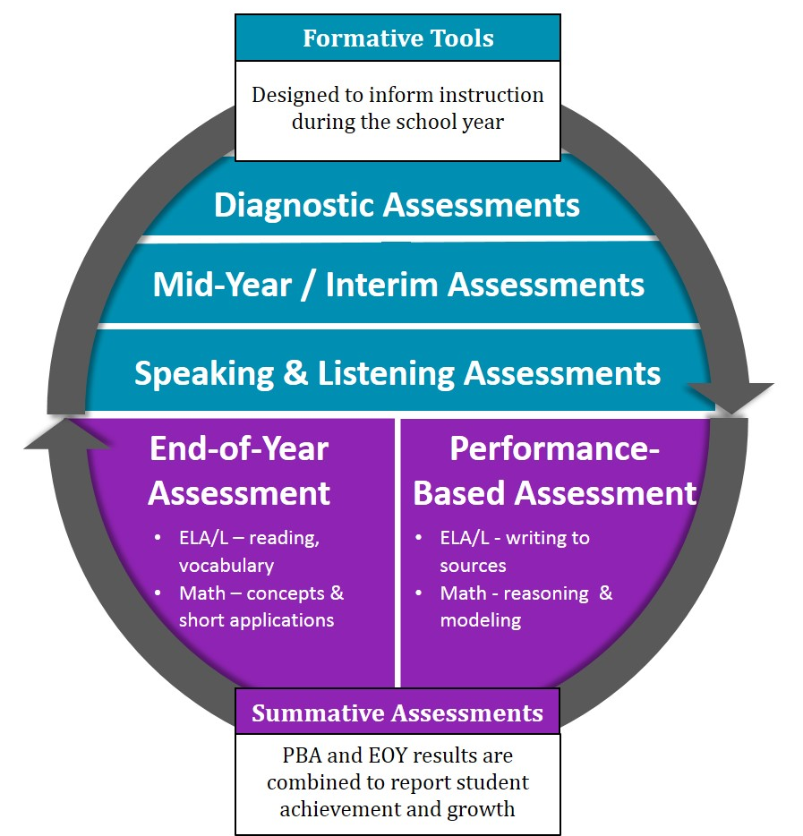
PARCC Assessment System

Slide 7

Updates and more information
E-mail me lslover@parcconline.org
Follow us on Twitter @parccplace
Visit our website www.parcconline.org
Sign up for the PARCC Updates newsletter on our website
Sign up for the PARCC Updates newsletter at www.parcconline.org

