Slide 1
How are Graduation Requirements Impacted by PARCC?
October 22, 2014

Slide 2
Maryland State Department of Education
Division of Curriculum, Assessment, and Accountability
200 W. Baltimore Street
Baltimore, MD 21201
www.MarylandPublicSchools.org
Lillian M. Lowery, Ed.D.
State Superintendent of Schools
Charlene M. Dukes, Ed.D.
President, Maryland State Board of Education
Martin O'Malley
Governor
Jack Smith
Deputy State Superintendant
Teaching and Learning
Henry R. Johnson
Assistant State Superintendant
Division of Curriculum, Assessment, and Accountability
Notes:
Introduction

Slide 3
Purpose
Learn how graduation requirements will be impacted by the transition to the Partnership for Assessment of Readiness for College and Careers (PARCC) assessments. In particular, the focus of the discussion will include the changes to the Code of Maryland Regulations (COMAR) and the transition timeline from the assessments within the Maryland High School Assessment program (HSA) to the PARCC assessments.

Slide 4
Guiding Legislation
Annotated Code of Maryland (Ann. Code)
  Statutes
    The Legislature enacts statutes.
Code of Maryland Regulations (COMAR)
  Regulations
    Administrative agencies (MSDE) adopt, amend and repeal regulations under the authority granted to them by statutes. Unless the Legislature has created an exemption, agencies must follow the procedures in the Administrative Procedure Act when adopting, amending or repealing regulations.

Slide 5
COMAR Adoption Process
State Board approves Regulations
for publication
Notice and Text Published in the Maryland Register
Public Comment
(30 Days)
Adopted by the State Board
Notice Published
Effective
MSDE reviews and modifies regulation

Slide 6
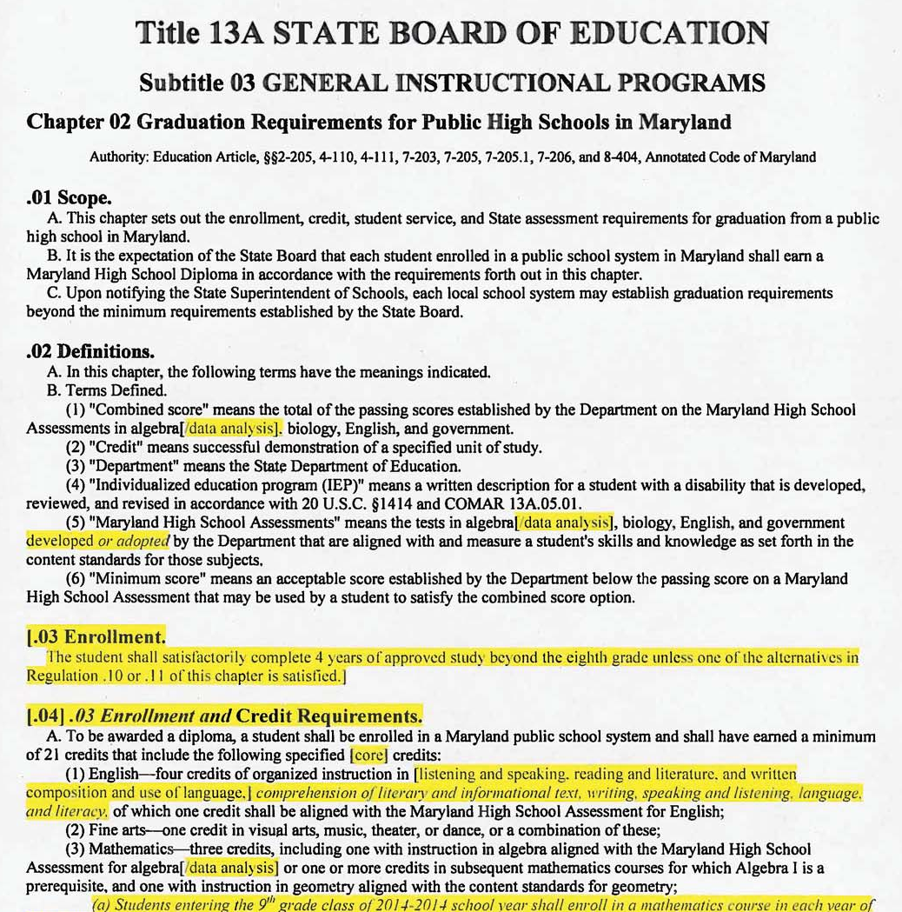

Slide 7
Maryland High School Diploma
To be awarded a Maryland high school diploma
  Complete the enrollment, credit, and service requirements
  Complete local school system requirements; and
  Satisfy one of the following:
    Achieve a passing score on the Maryland High School Assessments for algebra, biology, English, and government;
    Achieve an overall combined score on the Maryland High School Assessments for algebra, biology, English, and government;
    Achieve a score on Department-approved substitute assessments for algebra, biology, English, and government, aligned with the Maryland High School Assessments such as Advanced Placement examinations, SAT I, SAT II, and International Baccalaureate examinations; or
    If the student is unable to meet the requirements in §B(3)(a)—(c) of this regulation, then satisfactorily complete the requirements of the Bridge Plan for Academic Validation

Slide 8
High School Credit Requirements
9th graders in 2015
  Enroll in a mathematics course in each year of high school
  Up to a maximum of four years
    Unless math course needed to meet graduation requirements in 5th/6th year
Subject Area | Credits
English | 4
Mathematics | 3
Science | 3
Social Studies | 3
Fine Arts | 1
Physical Education | ½
Health Education | ½
Technology Education | 1
Other | 5
World Language (2) Advanced Tech Ed (2) CTE Program (4) | 2
Electives | 3
Total Credit Requirements | 21

Slide 9
Recent Initiatives impacting Graduation Requirements
Common Core
Partnership for the Assessment of College and Career (PARCC)
College and Career Readiness (CCR)
Part of the federal government's American Recovery and Reinvestment Act Program
Grant awarded to Maryland on August 2010 of $250 million over 4 years
http://marylandpublicschools.org/MSDE/programs/race_to_the_top
Consortium of 24 states working together to develop an assessment system aligned to the Common Core State Standards
Anchored in college and career readiness; provide comparability across states; and be able to assess and measure higher-order skills such as critical thinking, communications, and problem solving.
http://www.marylandpublicschools.org/msde/testing/parcc/overview.htm and http://www.parcconline.org
Increasing the number of students ready to enter college or career at the end of high school
State-led effort coordinated by the National Governor's Association and the Council of Chief State School Officers
Establishes a set of shared goals and expectations for what students should understand and be able to do in grades K-12 in order to be prepared for success in college and the workplace
Adopted by Maryland State Board of Education in June 2010
http://marylandpublicschools.org/MSDE/programs/ccss
Race to the Top (RTTT)

Slide 10
High School Assessed Courses
HSA
PARCC
Algebra I
Biology
English 10
Government
Algebra I
Algebra II
English 10
Pending:
  English 9
  English 11
  Geometry

Slide 11
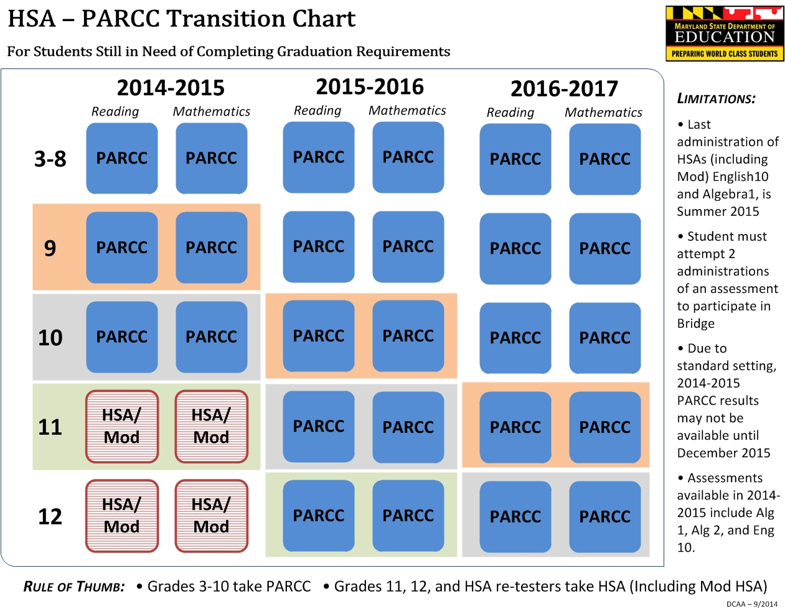

Slide 12
USM Freshman Admission Requirements
Minimum Core Content Proficiency Requirements
C or better to demonstrate competency
Math must include
  Algebra I,
  Geometry, and
  Algebra II.
Subject Area | Year Courses
English | 4
Biological and Physical Sciences | 3
Social Science/History | 3
Mathematics | 4
Language other than English or Adv. Tech. Ed | 2

Slide 13
College and Career Readiness and College Completion Act of 2013¹
Establishes a number of requirements aimed at increasing college and career readiness and college completion in the State.
  Goal of the state that all students achieve mathematics competency in Algebra II
  (Md. Education Code Ann. § 7-205.1(d))
  College and Career Readiness Assessment
  Transition Courses

Slide 14
High School Curriculum
College Readiness Assessment
  2015-2016 SY
  All students must be assessed, by 11th grade, for college readiness, using acceptable college placement cut scores, in:
    English language arts, and Literacy
    Mathematics
Transition Courses
  2016-2017 SY
  MSDE develops and implements transition courses for 12th grade students who have not achieved college and career readiness by the end of 11th grade

Slide 16
Other Considerations from College and Career Readiness and College Completion Act of 2013
College and Career Counseling
Dual Enrollment
Maryland High School Diploma Study

Slide 17
Contact Information
Chandra Haislet
Director,
Accountability and Data Systems
Chandra.Haislet@maryland.gov
410.767.0025
Doug Strader
Director,
Assessment and Planning
Douglas.Strader@maryland.gov
410.767.0048

Slide 18
