Slide 1

Accessibility Features and Accommodations
Ensuring Access for All Students

Slide 2
Outcomes
Guided exploration on the importance of accessibility for every student during instruction
Guided exploration of the accessibility features and accommodations available on the PARCC assessments

Slide 3
What does equitable access to grade-level content mean in everyday instruction?

Slide 4
Accessibility, Accommodations, Universal Design
Universal Design for Learning (UDL) and Assessment levels the playing field for every student. One tool that may be helpful in providing ideas for instruction is the UDL wheel.
Here is a link to the wheel: http://udlwheel.mdonlinegrants.org/

Slide 5

Universal Design for Learning Wheel

Slide 6
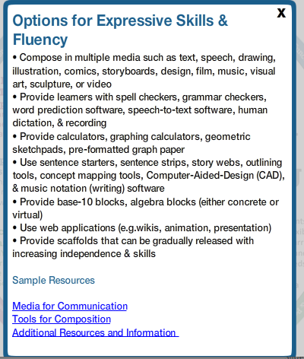
Action and Expression
Options for expression and communication:

Slide 7
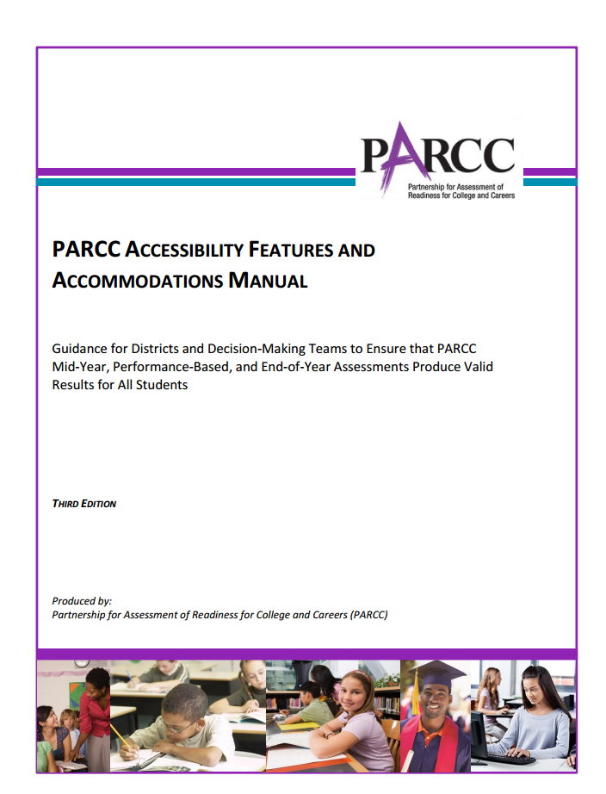
PARCC Accessibility Features and Accommodations Manual
PARCC Accessibility Features and Accommodations Manual
http://www.parcconline.org/parcc-accessibility-features-and-accommodations-manual

Slide 8
The PARCC Accessibility System
Features for All Students
Accessibility Features*
Identified in advance
Accommodations**
* Available to all participating students
**For students with disabilities, English learners, and English learners with disabilities

Slide 9
Section 2: PARCC Accessibility System and Accessibility Features for All Students Taking the PARCC Assessments
Accessibility Features Available for All Students: pages 22 -26
Accessibility Features Available for All Students: pages 22 -26
Features for All Students Identified in advance
Accessibility Features
Accommodations
Audio amplification | Blank paper | External spell check device
Eliminate answer choices | Notepad | Writing tools
Line reader tool | Magnification device | Redirect student to the test
Flag items for review | General administrative directions clarified | General administrative directions read aloud and repeated as needed
Highlighting tool | Headphones or noise buffers | Pop-up glossary
Frequently Asked Questions answered in Section 2:
Where can I find more information about the accessibility features available to all students?
What test administration considerations are available for all students?

Slide 10

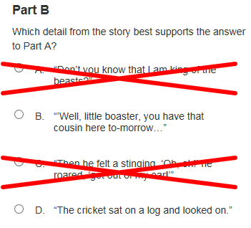


Accessibility Features for All Students
Complete list on pages 22 - 26

Slide 11
Accessibility Features for All Students
Accessibility Features for All Students
Computer-Based Testing | Paper-Based Testing
Audio Amplification | Auditory Aids
Blank Paper | Blank Paper
Eliminate Answer Choices | Visual Aids/Organizers
Flag Items for Review | Visual Aids/Organizers
General Administration Directions Clarified | General Administration Directions Clarified
General Administration Directions Read Aloud and Repeated as Needed | General Administration Directions Read Aloud and Repeated
Highlight Tool | Highlighter
Headphones or Noise Buffers | Headphones or Noise Buffers
Line Reader Tool | Line Reader (Straight Edge)
Magnification/Enlargement Device | Magnification/Enlargement Device

Slide 12
Discussion Questions
Choose two accessibility features available for all students.
Discuss how these features may support students.
Discuss how these features could be used during instruction and what they look like in routine instruction.
Discuss if these features could distract some students.

Slide 13
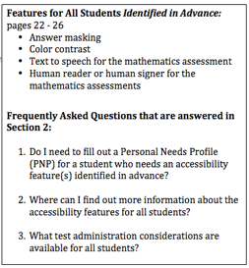
Features for All Students: Identified in advance

Slide 14
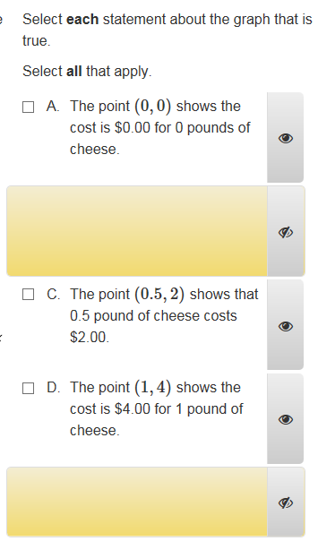
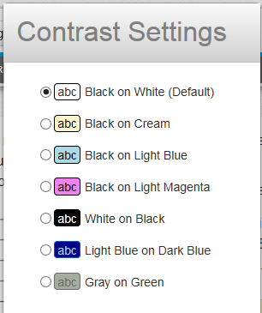
Features for All Students: Identified in advance
Complete list on pages 22 - 26
FAQ answered in Section 2:
Do I need to fill out a Personal Needs Profile (PNP) for a student who needs an accessibility feature(s) identified in advance?
Where can I find more information about the accessibility features available for all students?
What test administration considerations are available for all students?

Slide 15
How can school teams determine which students need these features?

Slide 16

Practice Tests and Tutorials
  Located under Test Preparation on PARCC.pearson.com

Slide 17
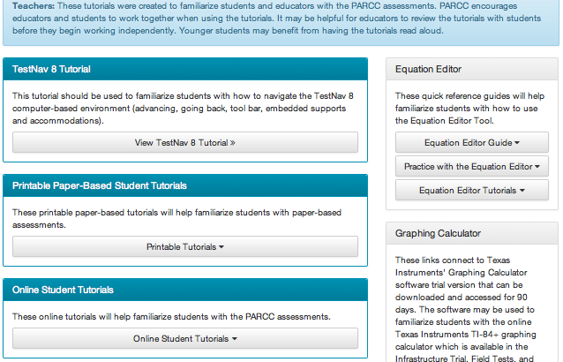

Slide 18
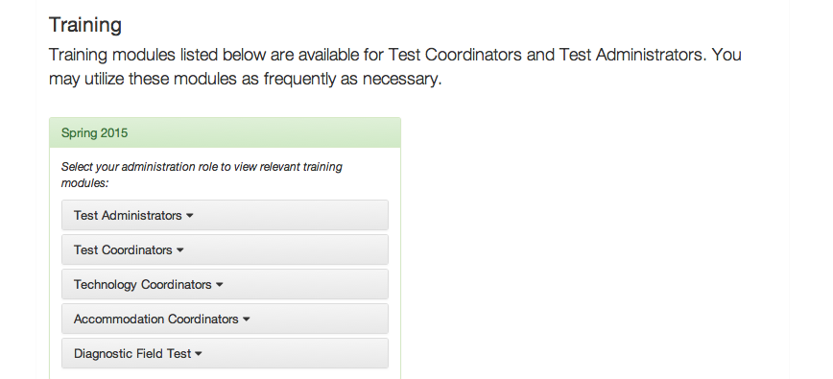
Other Trainings Available

Slide 19
Now that you have had time to explore the accessibility features that are available for all students, consider how this might change how you design everyday instruction.

Slide 20
How can educators collaborate to ensure that needed accommodations are provided during instruction so all students have the accessibility features and accommodations necessary for their success?

Slide 21
How can all educators collaborate to ensure that the English learners and English learners with disabilities in all classrooms receive the accommodations necessary for their success?
Collaboration

Slide 22
Recap
Outcomes:
Guided exploration on the importance of accessibility for every student during instruction
Guided exploration of the accessibility features and accommodations available on the PARCC assessments

Slide 23
Resources
Accommodations Manual: http://www.parcconline.org/parcc-accessibility-features-and-accommodations-manual
PD Modules: http://www.parcconline.org/professional-learning-modules-parcc-assessments
Training Modules: http://parcc.pearson.com/manuals-training/
Practice Tests & Sample Items: http://parcc.pearson.com/practice-tests/
UDL Wheel: http://udlwheel.mdonlinegrants.org

