Slide 1
Maryland State
Department of Education
Assessments in Maryland: A Work in Progress
October 19, 2015

Slide 2

Student Assessments
“the use of testing as a tool for learning”
Brown, Roediger & McDaniel, 2014 Make It Stick
1
Notes:
Recently read “Make It Stick” by Peter Brown, Henry Roediger & Mark McDaniel
“…If we stop thinking of testing as a dipstick to measure learning – if we think of it as practicing retrieval of learning from memory rather than testing, we open ourselves to another possibility: the use of testing as a tool for learning.”
Before talking about assessments and the learning process, I want to review the brief history of state-mandated assessments in Maryland

Slide 3
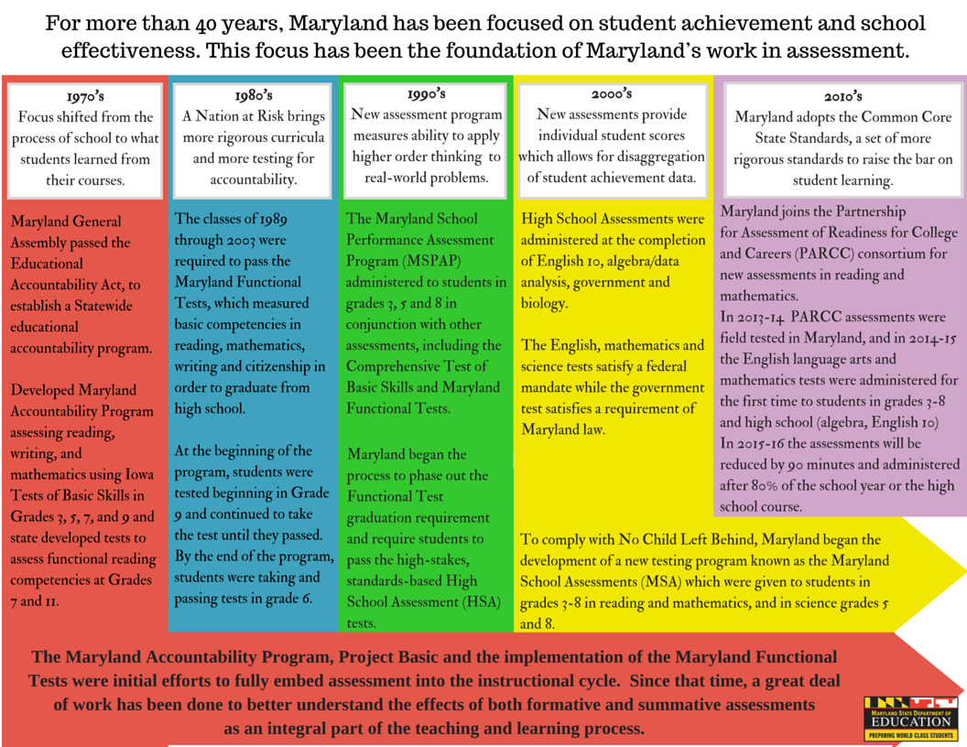
2
Notes:
For decades prior, states had mandated assessments
Evolved over time – like building blocks
Provided varying levels of information about student achievement
Group, individual data
Maryland made significant modifications to its accountability system approximately every decade beginning in the 1970s
1970’s - Maryland Accountability Program – focus shifted from strictly the process of school to what students learned
Maryland Accountability Program and Project Basic
1980s - A Nation at Risk brings more rigorous curricula and more testing for accountability
Maryland Functional Tests – competency standards for graduation
Were initial efforts to fully embed assessment into the instructional cycle
1990s – Standards-based reforms – MSPAP, CTBS and Functional Tests
Call for curricula that focused on reasoning, conceptual understanding and the ability to apply knowledge to real-world problems
Maryland was looking for a way to ensure students graduated with a base of knowledge greater than the minimal competencies
HSAs first administered in 2000
2000s – MSAs at elementary and middle school levels developed to comply with NCLB requirement for individual student scores
Based on voluntary curriculum
Were disaggregated by student groups – opened a conversation about the disparity in achievement among various groups
2010s – Adoption of Common Core – more rigorous standards
PARCC assessments

Slide 4

Student assessments have a variety of purposes.
Assess learning
Shape instruction
Determine placement
Serve as graduation requirement
Inform educator evaluations
Be used in accountability systems
Inform return on investment
3
Notes:
We have known for quite some time that well-designed assessment program can
Assess student learning at end of instruction (summative)
Shape instruction (formative)
Determine program placement
Serve as graduation requirement
Provide information for educator evaluations
Hold schools, systems and educators accountable
Provide information about return on investment

Slide 5




Assessments of all types can help the learning process itself.
4
Notes:
So far, we have done fairly well at using assessment to measure achievement (a dip-stick for learning as the authors of Make It Stick say), but what do we know about using assessments to aid learning, to cement memory, to create foundational knowledge upon which all learning depends?
For after all, the central purpose of school is student learning.
Make It Stick talks about what research tells us about learning – some of which defies conventional wisdom.
Research shows that assessments provide a greater purpose than just providing a snapshot of what has been learned. They can, in fact, help the learning process itself.

Slide 6
Assessments help consolidate and produce more complex, durable learning.
Make it Effortful
Fluency can mask mastery
Interrupt forgetting
Retrieval strengthens learning
Feedback strengthens retention
5
Notes:
This is what research tells us about learning
Learning is deeper when it is effortful – not when it is easy.
We must be aware that there are times when fluency masks mastery.
Retrieval strengthens memory and interrupts forgetting.
Practice at retrieving new knowledge or skill from memory is a potent tool for learning and durable memory.
Effortful retrieval makes for stronger learning.
Repeated retrieval makes learning more durable and useful in varied situations.
Giving feedback strengthens retention.
Periodic practice interrupts forgetting.
Varied practice improves ability to transfer learning from one situation to another by consolidating learning.

