Slide 1

Writing in the common core
Maryland Assessment Group Conference
Wednesday, October 22, 2014

Slide 2
Session Objectives
Discuss the Maryland College and Career Ready (MCCR) standards for writing
Identify the components of effective writing
Use PARCC rubric to evaluate student writing

Slide 3

three types of writing outlined in common core
Argument
Informative/explanatory
Narrative

Slide 4
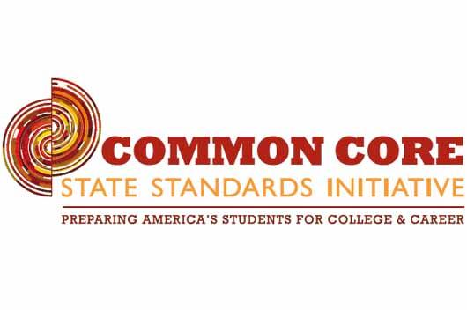
What does common core say about writing?
The Standards acknowledge the fact that whereas some writing skills, such as the ability to plan, revise, edit, and publish, are applicable to many types of writing, other skills are more properly defined in terms of specific writing types: arguments, informative/explanatory texts, and narratives.

Slide 5
What does common core say about writing?
Students can, without significant scaffolding, comprehend and evaluate complex texts across a range of types and disciplines, and they can construct effective arguments and convey intricate or multifaceted information.

Slide 6
What does common core say about writing?
They learn to appreciate that a key purpose of writing is to communicate clearly to an external, sometimes unfamiliar audience, and they begin to adapt the form and content of their writing to accomplish a particular task and purpose.

Slide 7
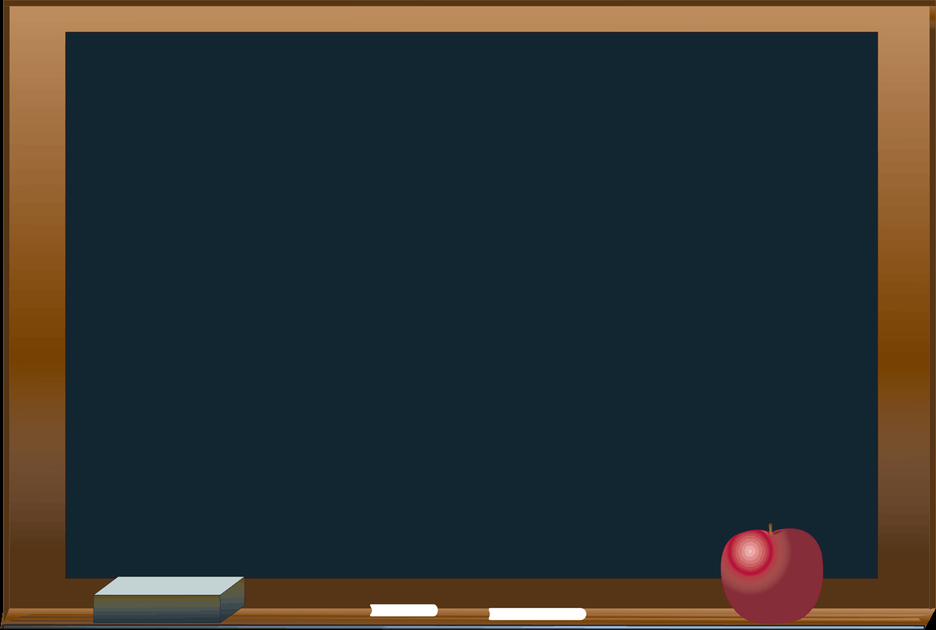
Teaching Writing/Supporting Students
MSDE Student Support Modules:
https://msde.blackboard.com
Login: msdeguest
Password: msdeguest

Slide 8
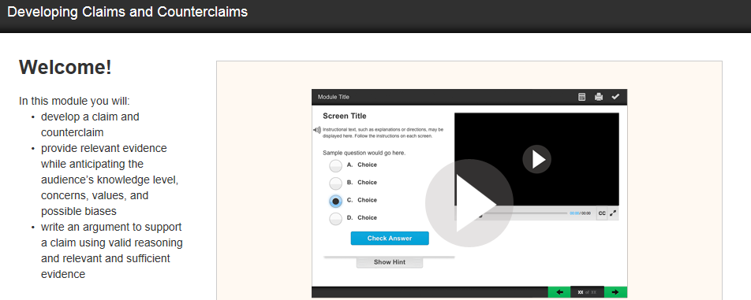
Argument Writing
Students analyze how the claims in an effective argument is supported with reasons and evidence.
Writers use specific claims to build their arguments. They support their claims with reasons and evidence.

Slide 9
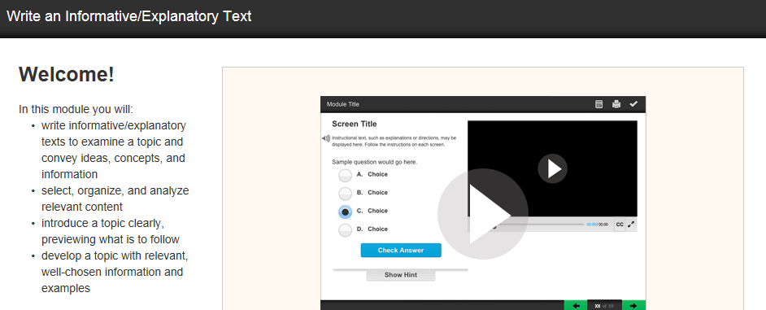
Informative/Explanatory Writing
Students write informative/explanatory text to examine and convey complex ideas, concepts, and information clearly and accurately though the effective selection, organization, and analysis of content.

Slide 10
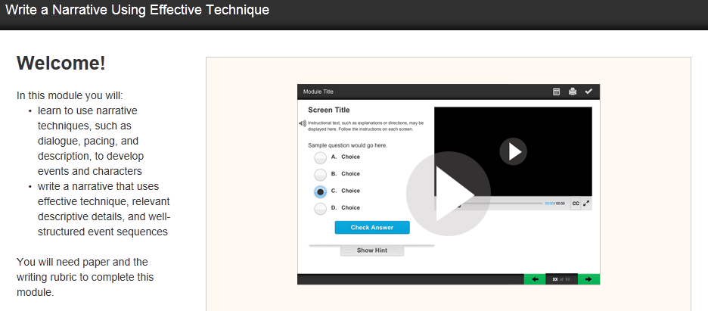
Narrative Writing
Students use narrative techniques, such as dialogue, pacing, and description, to develop experiences, events, and/or characters.

Slide 11
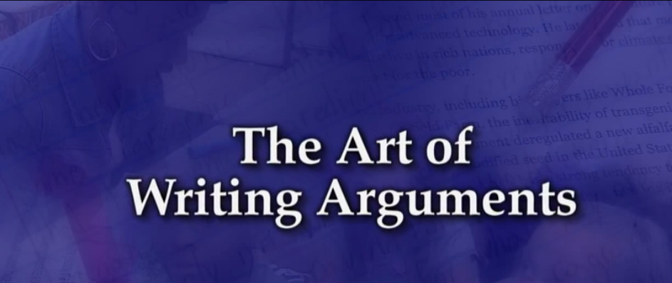
Looking at Writing in the Content Areas

Slide 12
Evaluating Student Proficiency With the Writing Standards
Focus
Clarity and coherence of student writing
Ability to support claims with sufficient evidence when writing analyses of text(s)
Included in Prompt
Purpose
Audience
Topic, issue, idea
References to source(s)
Form/genre

Slide 13
PARCC ELA/Literacy PBA Tasks
Research Simulation Task (RST)
Narrative Task (NWT)
Literary Analysis Task (LAT)

Slide 14
Prose Constructed Response (PCR): Alignment
PCRs should visibly align questions/tasks with specific Standards.
  The LAT and RST elicit evidence supporting the sub-claims for reading, written expression, and conventions
  The NT elicits evidence supporting the sub-claims for written expression and conventions only

Slide 15
Updated Rubrics
Please pull out your GRADES 6-11 CONDENSED SCORING RUBRIC FOR PROSE CONSTRUCTED RESPONSE ITEMS
Scoring Rubric Traits:
Reading Comprehension of Key Ideas and Details
Written Expression
  Development of ideas
  Organization
  Clarity of language
Knowledge of Language and Conventions

Slide 16
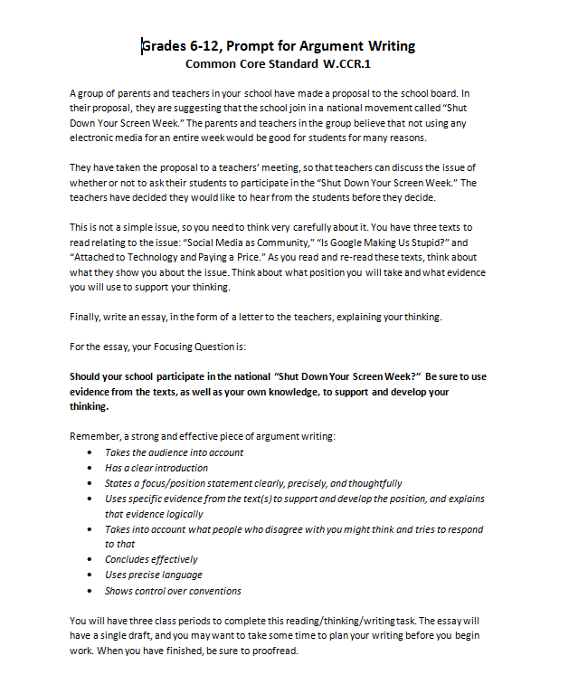

Activity : engage with samples from achievethecore.org to examine teaching writing

Slide 17

Activity: provide effective feedback
Read the student sample
Assign a score for each area
Using the language of the rubric, provide appropriate comments where necessary

Slide 18
Activity #2: Scoring Student Writing
What score did you assign to each area of the scoring rubric?
Reading Comprehension of Key Ideas and Details: _________
Written Expression: _________
Knowledge of Language and Conventions: ___________

Slide 19
Additional resources
www.achievethecore.org
msde.blackboard.com
Parcconline.org
http://www.corestandards.org/ELA-Literacy/

Slide 20
Thank you
Please contact MSDE staff with additional questions:
Ava Spencer, ava.spencer@maryland.gov
Kanika Dorsey, kanika.dorsey@maryland.gov

