Slide 1
Advancing Success for Black Males: Learning from the ETS Promoting Promising Practices Series
Jonathan Rochkind
Senior Director
Policy Evaluation Research Center
Educational Testing Service

Slide 2
ETS Mission
To help advance quality and equity in education by
  providing fair and valid assessments,
  research and
  related services.
Our products and services
  measure knowledge and skills,
  promote learning and performance,
  support education and professional development
for all people worldwide.

Slide 3
Policy Evaluation & Research Center (PERC)
Research, collaborate and evaluate
Increase overall educational attainment
Narrow opportunity gaps between advantaged and disadvantaged groups
- representation, achievement & attainment

Slide 4
PERC Research Projects
2014
Project |  | Partner |  | Funder
GO College |  | Council for Opportunity in Education (COE) |  | U.S. DOE
NCIN |  | American Association of Colleges of Nursing (AACN) |  | RWJ Foundation
SITES-M |  | Tennessee State University (TSU) |  | TN DOE and U.S. DOE
Algebra Project Logic Model |  | The Algebra Project |  | NSF

Slide 5
PERC: Applying Research to Practice
2014
Project |  | Partner |  | Funder
MATH-UP |  | Lehman College |  | U.S. DOE
EEP |  | National Urban League (NUL) |  | Bill and Melinda Gates Foundation

Slide 6

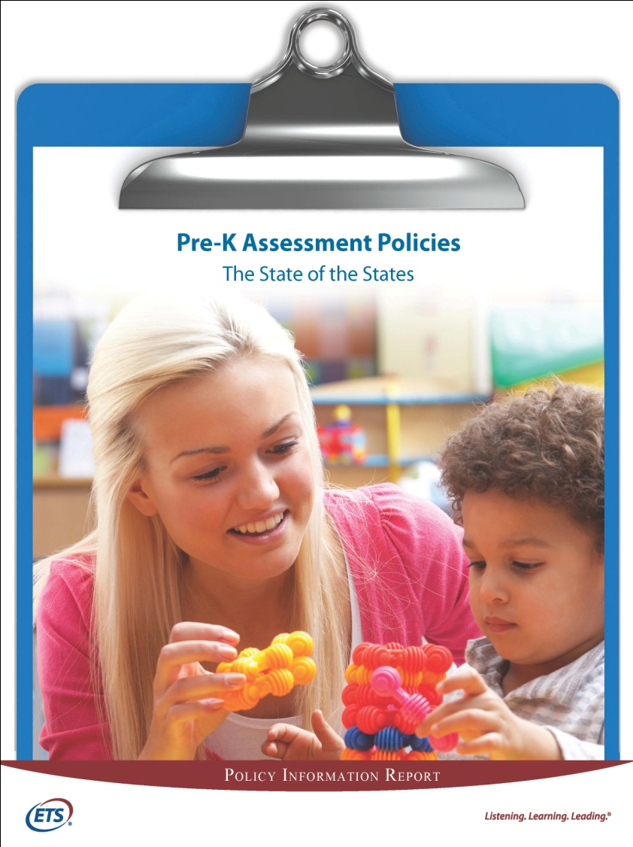

Producing Policy Research
Recently Released
Upcoming Release

Slide 7
Addressing Achievement Gaps Symposiums

Slide 8
Overview
ETS has held 18 Addressing Achievement Gaps Symposiums
The past four Promising Practices series, focused on Black males.
Collaboration with the Children Defense Fund

Slide 9
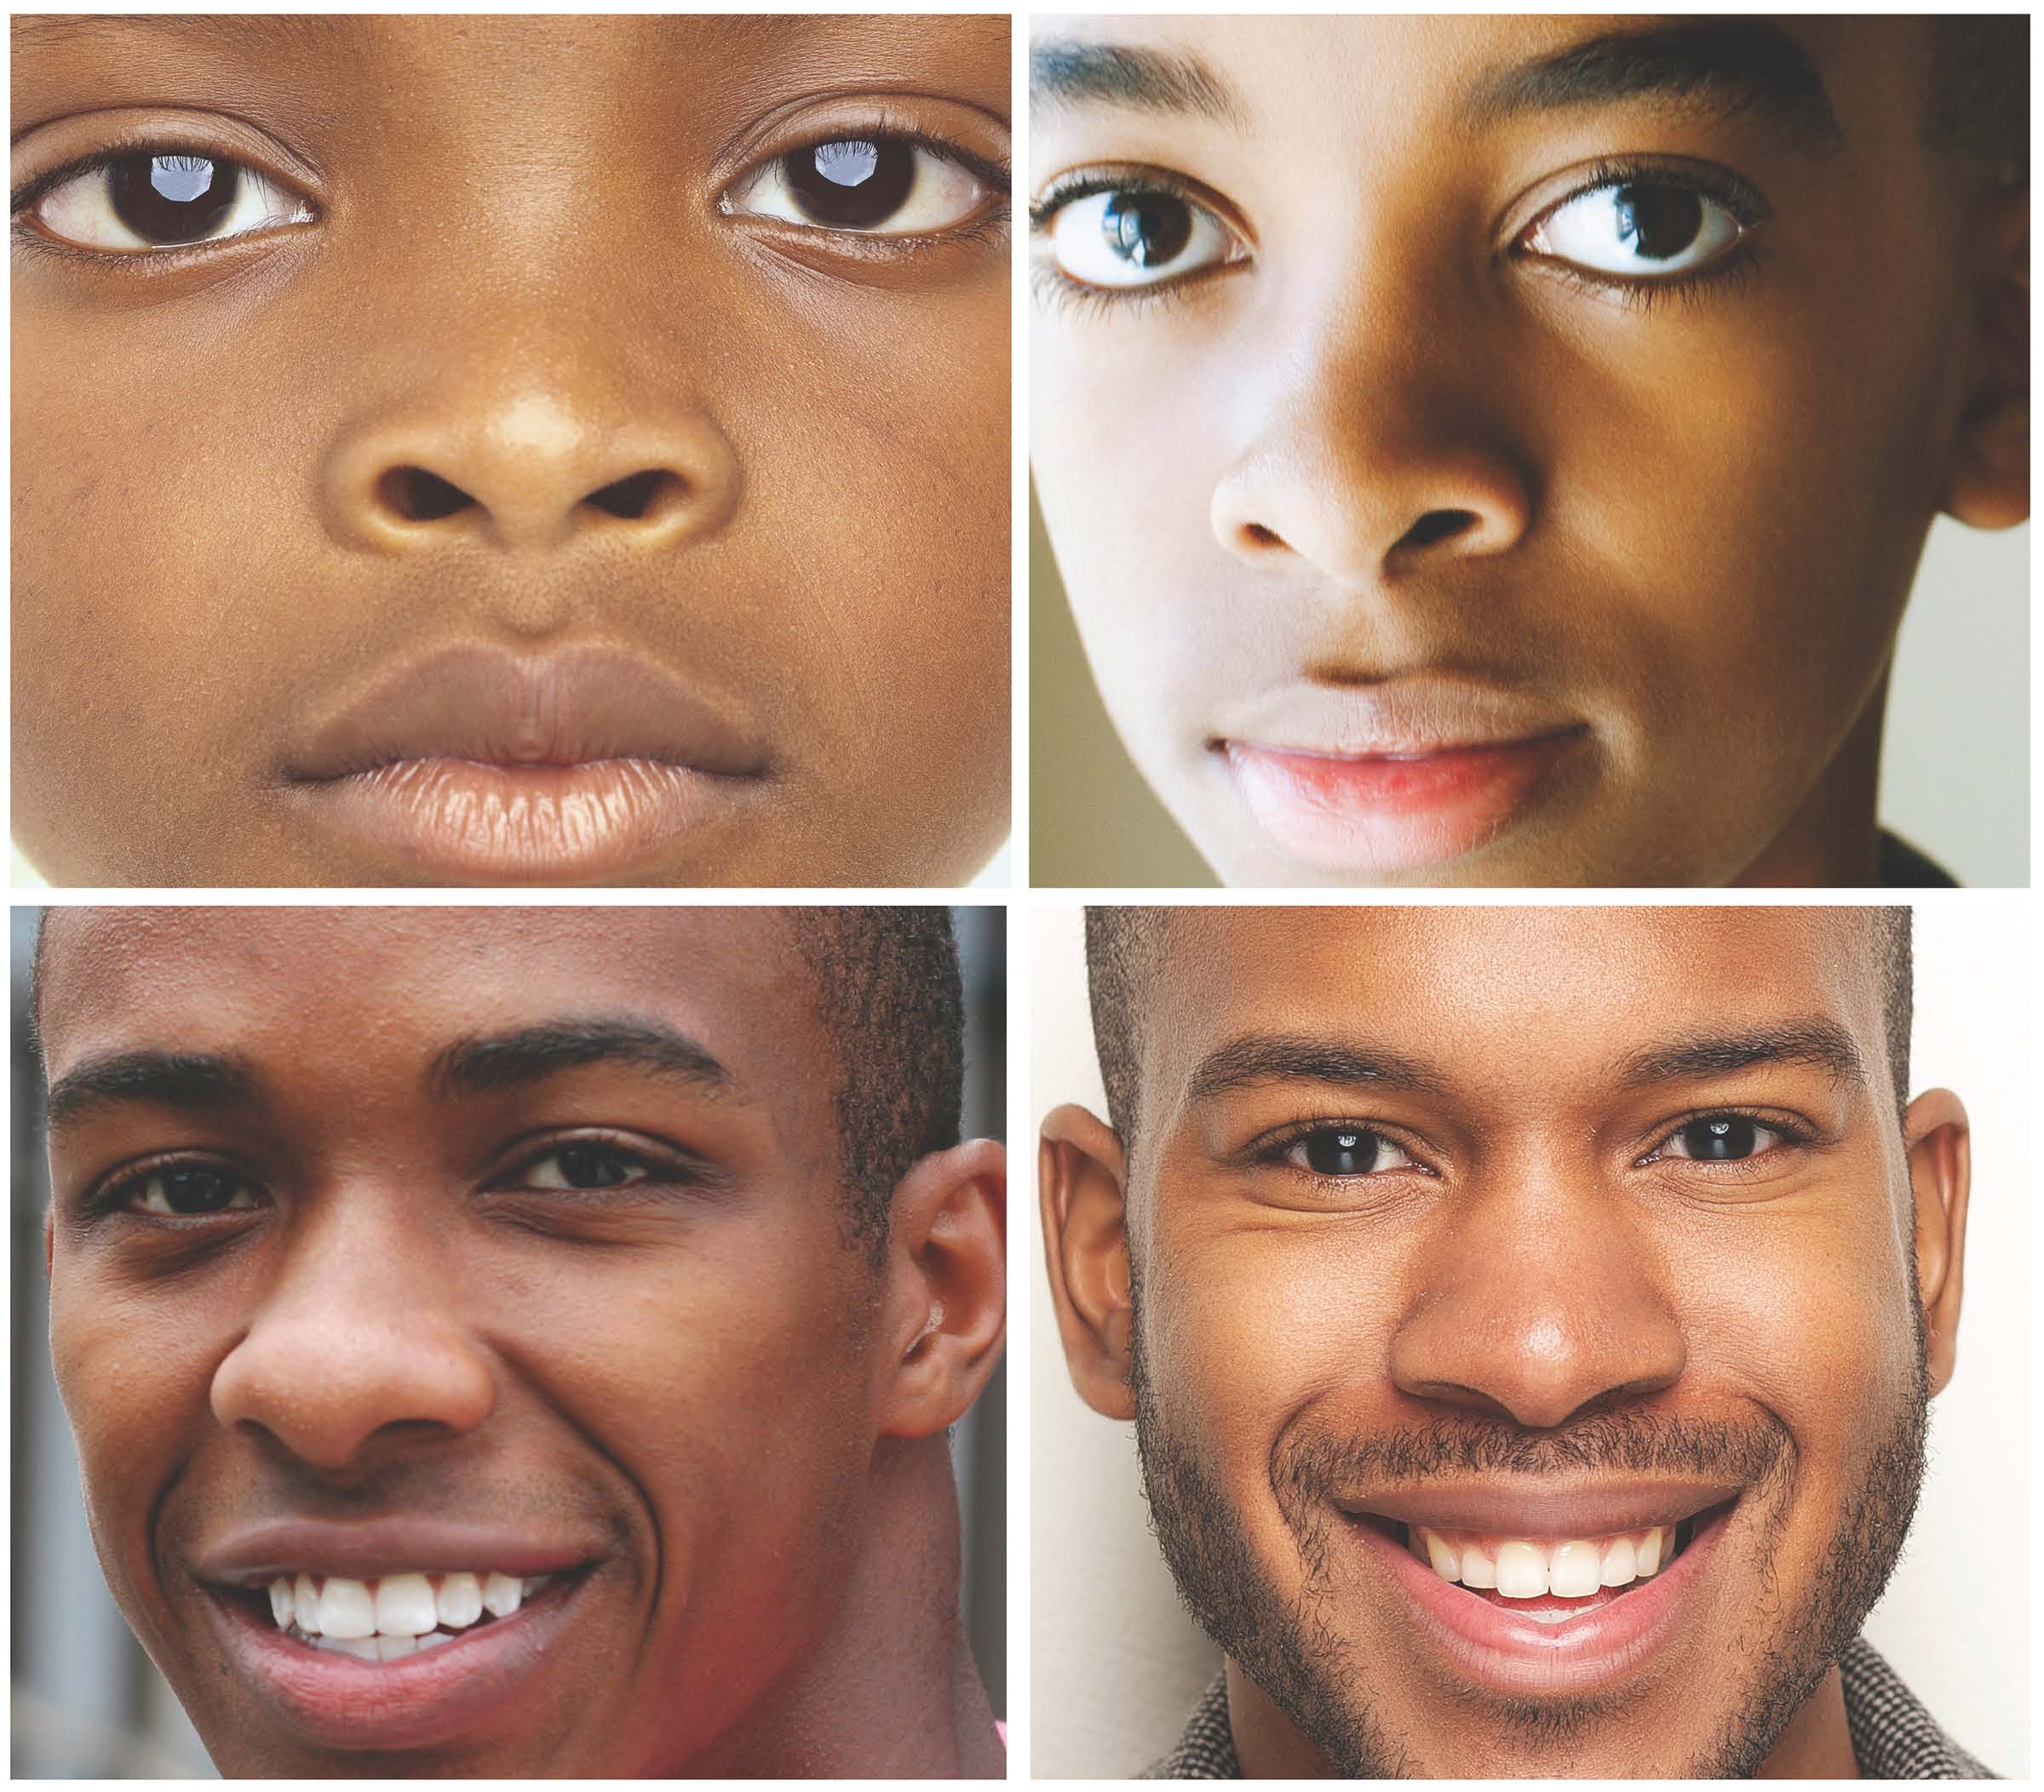
Promoting Promising Practices

Slide 10
Highlights from the symposiums

Slide 11
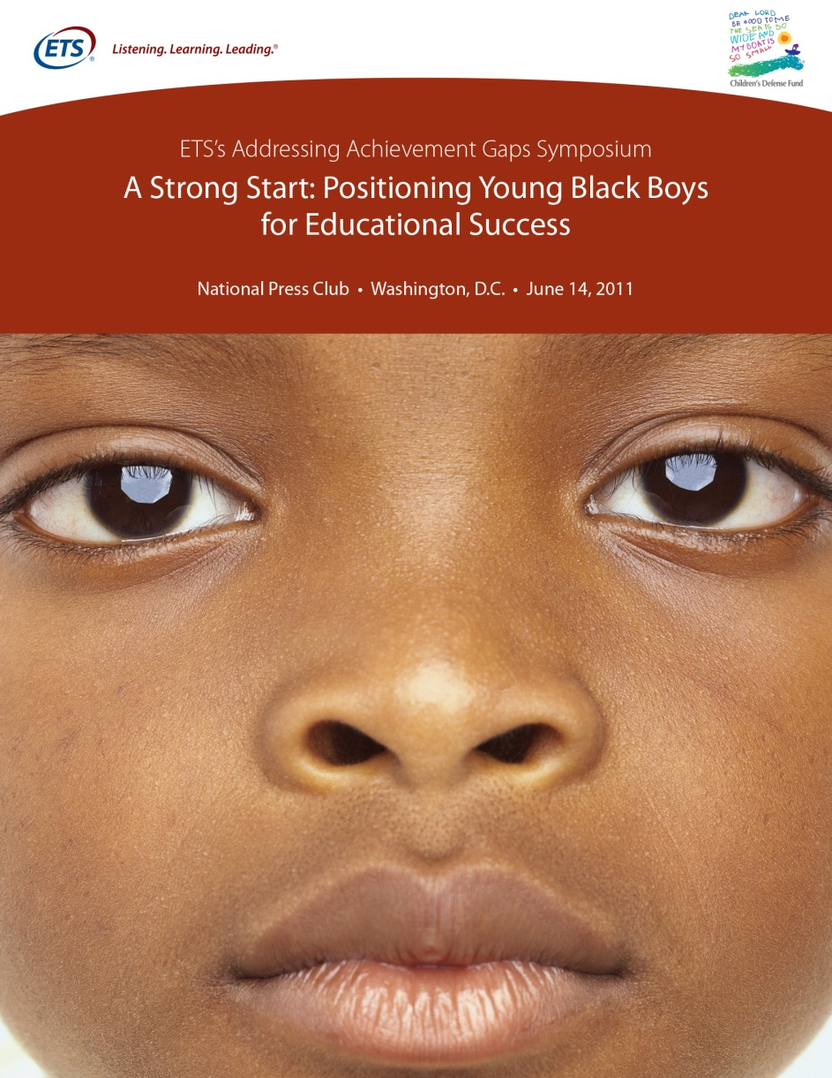
Focus on U.S. 3.5 million Black males from birth to age 9
Explored connections between early development and later achievement
Advantages to a well designed pre-K to 3rd grade pipeline
Promising policy initiatives that address the holistic needs of Black boys
2011

Slide 12
Socio-Economic Concerns
 | Black Children | White Children
Infant Mortality | 13.2% | 5.6% ¹
Low Birth Weight | 13.8% | 7.2% ²
Have no Insurance | 12.0% | 7.0% ³
¹Source: Annie E. Casey Foundation. 2010. 2010 Kids Count Data Book: State Profiles of Child Wellbeing Baltimore, MD
² Source: U.S. Census Bureau: 2010 Annual Social and Economic Supplement (ASEC) to the Current Population Survey.
³Ibid

Slide 13
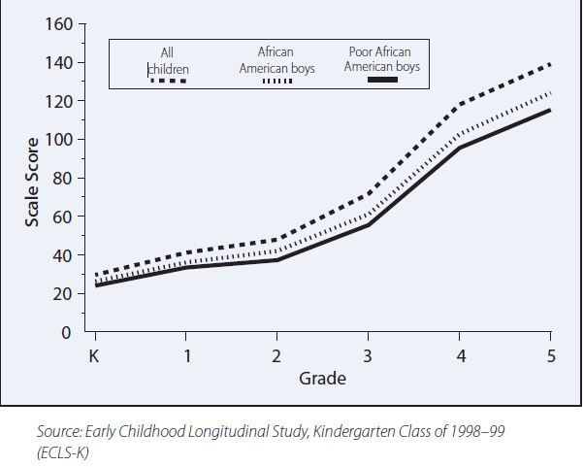
Low Income Black Boys Have a Wider Gap in Reading Scores

Slide 14
Early Development Concerns
 | Black Children | White Children
Letter recognition at Age 4 | 28% | 37%
Number/shape recognition | 55% | 73%
Source: Aud, S., Fox, M. A., & Kewal Ramani, A. (2010). Status and trends in the education of racial and ethnic
groups (NCES 2010-015). Washington, DC: Government Printing Office.

Slide 15
Focus on Solutions
“Poverty is a factor, but children whose mothers are responsive are more likely to actively engage in their environment, have longer attention spans, relate better to others, persevere when frustrated, have higher tolerance for frustration and be less anxious themselves. These are factors for school success.”
      Alisha Ray, SVP for Academic Affairs and Dean of Faculty at the Erikson Institute

Slide 16
Focus on Solutions
“Committed and responsible fathering during a child’s infancy contributes to emotional security, curiosity, and math and verbal skills.”
      Vivian Gadsden, Gadsden National Center on Fathers

Slide 17
Pre-K to 3rd Grade Pipeline Example
In the Bremerton School District, WA, a community centered pre-school with a research based approach, monthly PD sessions, and assessment, saw a 61% growth for the number of children who could recognize letters
      Linda Sullivan-Dudzic, Special Programs Director, Bremerton School District

Slide 18
Policy Recommendations
Abolish the law that allows the drop- out age of 16
Compel parent involvement
Support early childhood and cognitive development
Create adult programs for Black males and others to “upgrade education at home.”
      Ronald Rice, NJ State Senator

Slide 19

Focus on 1.5 million Black boys between 9-13 years of age
Topics included:
  Physical, emotional, and social transitions of Middle School
  Teacher attitudes towards black boys
  Lack of role models

Slide 20
The Facts: Percent of Boys Age 9-13 Who…
 | Black Children | White Children
Live in poverty | 36% | 12%
Live in extreme poverty | 17% | 5%
Say their classmates do not care about their feelings | 15% | 7%
Say they do homework 5 days a week | 47% | 35%
Say parents help with homework 5 days a week | 26% | 14%
Source: U.S. Census Bureau. 2011. “Current Population Survey, Annual Social and Economic Supplement”
Source: Early Childhood Longitudinal Study. 2007. Spring 2007 Grade 8 Student Questionnaire
Source: U.S. Department of Education, 2011 ”Digest of Education Statistics”

Slide 21
Higher Suspension Rates, Newer Teachers
Notes: Suspension rates count the number of students suspended at least one time during a school year.
Source: Daniel J. Losen and Russhel J. Skiba. Suspended Education: Urban Middle Schools in Crisis, Montgomery, AL: Southern Poverty Law Center, 2010.
Source: Office for Civil Rights, Revealing New Truths about Our Nation’s Schools, U.S. Department of Education, March 2012.

Slide 22
On NAEP Math, African-American Students Trail White Students in Every Age Group
Source: U.S. Department of Education, National Center for Education Statistics. National Assessment of Educational Progress, 1978-2012 Long-Term-Trend Mathematics Assessment. This report was generated by using NAEP Data Explorer, http://nces.ed.gov/nationsreportcard/
Notes:
Nettles - ECS - July 2007
10/21/14 14:23
22

Slide 23
Perceptions Matter
“Because these little souls are Black, they are treated differently”
      David Wall Rice, Associate Professor, Morehouse College
“[Negative stereotypes of Black teens] are poisonous and they really undermine kids’ sense of themselves and potential for being successful.”
      Mia Smith-Bynum, Associate Professor of Family Science, U of Maryland, College Park

Slide 24
Education Matters
“Middle-class Black boys are still below proficiency in terms of reading, so it’s not just a question of socio-economic status.”
      Mary Evans Sias President, Kentucky State University

Slide 25
Forging a Counter-Narrative
Speakers talked about building psychological armor to shield from negative messages.
Knowledge of historical context is seen as essential

Slide 26
Forging a Counter-Narrative
“They have to know stuff didn’t happen by accident…without that knowledge you’re just cast into the sea, and you’ve got to figure out how to swim with no type of protection at all.”
      David Wall Rice, Associate Professor of Psychology, Morehouse College

Slide 27
Mentors and Role Models
“Until teachers earn more money, we will not ever have the number of teachers we really need, especially Black men.”
      Wanda Hutchinson, Associate Professor of Education at Athens State
“…authentic, caring, competent, highly-qualified teachers, no matter the gender, no matter the race, have a profound impact on Black Males”
      Tyrone Howard, Professor, Graduate School of Education and Information Studies, UCLA

Slide 28
Discussed Proposals
House K-8 in one building
Single sex classes
Curriculum that connects to Black boys lives:
  “Black boys can learn just as much as anybody if you make it fun, interesting and dynamic. Don’t take the rigor out of it, but make it relevant and interesting to them.”
  -Kriner Cash, Former Superintendent, Memphis TN

Slide 29

Focus on the 1.7 million Black boys between 15-19 years of age
Highlights included experiences and success stories of recent high school graduates

Slide 30
The Facts: Percent of High School Aged Boys Who:
 | Black Boys | White Boys
Feel unsafe going to/at school | 8% | 4% ¹
Attend high poverty schools | 18% | 2% ²
Attend “drop out factories:” | 25% | 5% ³
¹Source: Youth Risk Behavior Surveillance System. 2011. CDC. Retrieved from http://www.cdc.gov/mmwr/pdf/ss/ss6104.pdf.
²Source: U.S. Department of Education. 2011. “The Condition of Education”
³Source: The U.S. Department of Education, National Center for Education Statistics (1998-2011). Public Elementary/Secondary School Universe Surveys. Cited in: Balfanz, R., Bridgeland, J., Bruce, M., & Fox, J. Hornig (2013). Building a Grad Nation: Progress and Challenge in Ending the High School Dropout Epidemic – 2013 Annual Update. Washington, D.C.: Civic Enterprises, the Everyone Graduates Center at Johns Hopkins University School of Education, America’s Promise Alliance and the Alliance for Excellent Education. Retrieved from http://www.civicenterprises.net/MediaLibrary/Docs/Building-A-Grad-Nation-Report-2013_Full_v1.pdf

Slide 31
Low Graduation Rates, Low Earnings
Notes:52 percent of Black males who entered 9th grade in the 2006-07 school year graduated in four years, compared with 78 percent of White, Non-Latino males and 58 percent of Latino males.
Source: Schott Foundation for Public Education, 2012. The Urgency of Now: The Schott 50 State Report on Public Education and Black Males. Cambridge, <A: Michael Ho.
Notes: The Average dropout can expect to earn an annual income of $20,242, according to the U.S. census Bureau. That’s $10,386 less than the typical high school graduate and $36,424 less than someone with a bachelor’s degree.
Source: Frontline. “By the Numbers: Dropping Out of High School”. September 2012. Retrieved from http://www.pbs.org/wgbh/pages/frontline/education/dropout-nation/by-thenumbers-dropping-out-of-high-school.

Slide 32
New Ways of Thinking About High School
Urban Prep: All male charter school
  All students wear coat and tie, incoming freshmen receive coat at ceremony
    During ceremony, successful Black adults come to pledge support for the new class
“If you want to improve the outcomes for Black Males, we have to change ‘the music’, we have to change the way we do school.”
      Tim King, Founder Urban Prep Academies

Slide 33
High Expectations, High Standards
“You’ve got to show [Black boys college campuses]. It is not real in their minds. You’ve got to take them to a dorm…they’ve got to play video games in the student center.”
      David Banks, Head, Eagle Academy Foundation
“You get more Black men in college when you put in college prep classes, honors classes…”
      Ivory Toldson, Associate Professor of Counseling Psychology, Howard University

Slide 34
Relationships Matter
“The school didn’t care for us, that’s the idea we had.”
      Mike Ruff, high school graduate, DC
“There were no personal connections in the school unless you were related to someone…”
      Darryl Briggs, College student and GED earner

Slide 35

June 23, 2014, Washington Press Club
Focus on young Black men between 18-24
Topics include:
  Policies that promote access, persistence, completion
  Pathways to earn degrees and transition to careers
  Affordability and financing strategies
  Experiences of college-goers

Slide 36
Perceptions Matter
“The perceived cost of community college is even more daunting than the real figures. In one study, the average White family believed that a year of community college costs $7,000 to $10,000, while the average Black family put the cost at $40,000 to $50,000…White families estimated the annual cost of a public four-year college at $45,000 to $50,000, while Latino families put it at $90,000. These exaggerated perceptions can dissuade students from even applying to colleges they believe to be hopelessly unaffordable.” Terrell Strayhorn, Ohio State University

Slide 37
Interventions matter
“A little bit of help can aid students in enrolling in college…10 text messages [sent during the summer before registration] cost about $5-$7 per student.”—Ben Castleman, University of Virginia
“Researchers sent aides to tax preparer H&R Block to help families complete the federal financial aid form while they were filing their taxes; the 10-minute intervention increased college-going and college-persistence by 30 percent.” .”—Ben Castleman, University of Virginia

Slide 38
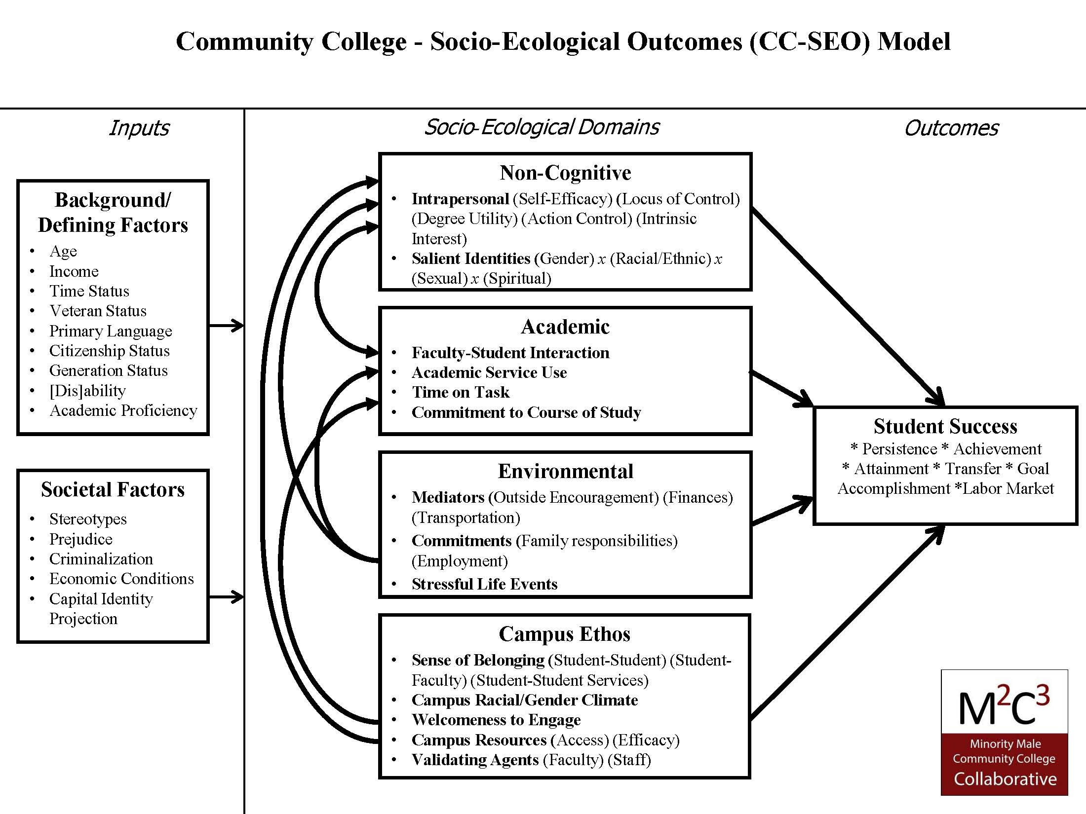

Slide 39
Tests Don’t Tell Us Enough
“…excessive focus on standardized testing: in some states, barely missing a cut-score can strand students in remedial courses that burn up tuition dollars and provide no college credit, putting a degree even further out of reach… The notion of college-ready or not is a false dichotomy… .You’re not 100 percent ready and 100 percent not. There’s a continuum. Even college-ready students struggle and need supports.” Michael Collins, Jobs for the Future
Notes:
Only 5 percent of African-American high school students earn ACT scores indicating college readiness, and 40 percent of the students enrolled in open-access institutions must take at least one remedial course, said speaker Michael Lawrence Collins, associate vice president of Jobs for the Future, a non-profit focused on college and career paths for low-income youths.
But a more serious problem than underpreparedness is the excessive focus on standardized testing , Collins said: in some states, barely missing a cut-score can strand students in remedial courses that burn up tuition dollars and provide no college credit, putting a degree even further out of reach. “We have to get away from that one-shot, high-stakes assessment,” he said. North Carolina, where research suggested that high school grades were at least as useful in placement as assessment test scores, has stopped using single cut-scores for college placement and instead uses multiple measures, including high school GPA and assessments of motivation; other states have taken a similar approach, Collins said. Using a single test score for college admissions promotes misleading beliefs about college readiness, he said. “The notion of college-ready or not is a false dichotomy,” Collins said. “You’re not 100 percent ready and 100 percent not. There’s a continuum. Even college-ready students struggle and need supports.”
Let’s discuss

Slide 40
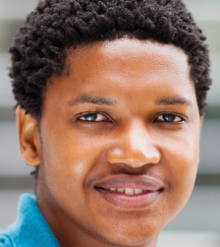
A Tale of Two Schools
30% of students
go to college
70% of students
go to college
Poverty culture
Transient population
Attendance – it’s a problem
Grades – Pass/Fail attitude
High School Graduation “Get student to graduation”
Outlook
“Do what you can to get by” Technology – not using school email
Children as Adults
(without the knowledge)
Middle class culture
Non-Transient population
Attendance – not an issue
Grades – A/B attitude
High School Graduation “Student will graduate”
Outlook
“Work your way up”
Technology – use school email
Children who are Children
Source: Millett conversation with a high school guidance counselor in May 2014

Slide 41
Contact us
For more information, including Statistical Profiles and Policy Notes: www.ets/org/achievementgap
To receive information on our next symposium: contact Jonathan Rochkind at jrochkind@ets.org

