Slide 1

Technology Readiness
Maryland 2014-2015
Notes:
Welcome to Technology Readiness for 2014-2015.

Slide 2
2014/2015 Admin Schedule
Assessment | Online/CBT Testing Dates
PARCC - PBA | March 2 – May 8
MSA Science | April 13 – May 1
HSA – April (Senior) | April 13 – April 17
PARCC - EOY | April 20 – June 5
HSA - May | May 18 – June 4

Slide 3
Agenda
Technology Guidelines
Technology Setup
  Configure the Network
  Proctor Caching
  SystemCheck Tool
  TestNav 8 and Proctor Caching Configurations
  Test Preparation (Practice Tests, TestNav 8 Tutorial, & Sample Items)
Infrastructure Trial
  Create Sample Students
  Create Sessions
  Manage Students in Sessions
Questions?
Notes:
An Introduction of Proctor Caching for TestNav
Proctor Caching – The Network
Requirements
What’s New
Setup and SystemCheck Overview
Configure TestNav Setup
PearsonAccess^{next} and Proctor Caching Setups
Test Coordinator Tasks
Proctor Caching Diagnostics
Additional Technical Notes
Further Reading

Slide 4
Technology Guidelines
TestNav 8 for PARCC Testing:
  Reference the Technology Guidelines for PARCC Assessments on the PARCC website.
http://www.parcconline.org/technology
TestNav 7.5 for other Maryland Administrations:
  Reference the TestNav site for Hardware and Software requirements.
http://www.pearsononlinetesting.com/TestNav/7/
Note: For Proctor Caching it is recommended that you use the newer version of Proctor Caching software posted here for PARCC testing:
http://parcc.pearson.com/technology-setup/
Notes:
For PARCC testing, the technology guidelines are posted on PARCC’s website: http://www.parcconline.org/technology
These guidelines provide the most up-to-date information on supported devices, hardware, operating system, browser, and network specifications; as well information on bandwidth recommendations, proctor caching requirements, computer-based accessibility features, embedded accommodations, and available online tools.
For TestNav 7 Hardware and Software requirements reference the TestNav website or PearsonAccess.com.
http://www.pearsononlinetesting.com/TestNav/7/
For Proctor Caching, we recommend using the newer version of the software posted on the Technology Setup section of http://parcc.pearson.com/.

Slide 5
TestNav Recommendation
Use a website landing page for Online Testing. When students start their browser the home page or school website should contain web links for each of their administrations. As an alternative use desktop shortcuts if a website page cannot be used.
PARCC Testing
  Production Testing:
    http://parcc-md.testnav.com
  Training:
    http://parcctrng.testnav.com
Maryland Administrations (Not PARCC related)
  Production Testing:
    http://testnav.com/md
  Training:
    http://testnav.com/mdtrng
Notes:
Use a website landing page for Online Testing. When students start their browser the home page or school website should contain web links for each of their administrations. As an alternative use desktop shortcuts if a website page cannot be used. Here are the four URLS that Maryland can bookmark. Note that parcc-md.testnav.com will be implemented come November 2014.

Slide 6
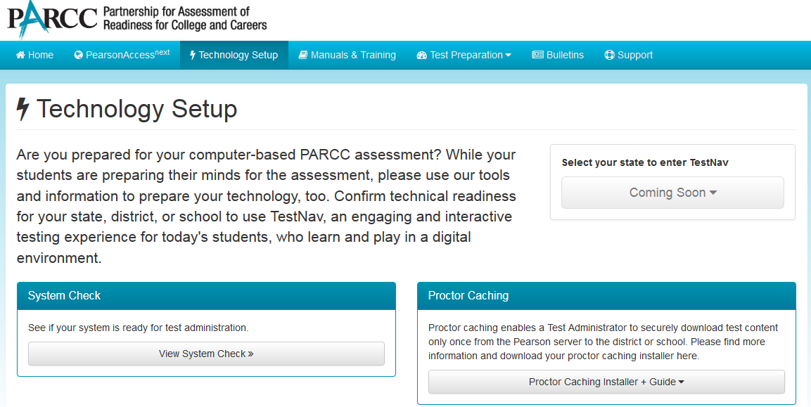
http://parcc.pearson.com
Notes:
For the rest of this presentation, all resources for PARCC are located at http://parcc.pearson.com. This website combines resources for PARCC testing into one website. Today we will focus mostly on the Technology Setup area of this website.

Slide 7
Technology Setup
Configure the Network
Proctor Caching
SystemCheck Tool
TestNav 8 and Proctor Caching Configurations
Test Preparation (Practice Tests, TestNav 8 Tutorial, & Sample Items)
Notes:
Technology Setup encompasses the multiple steps Technology Staff will complete in order to prepare for the administration of PARCC assessments.
For the Technology Set-up, it is recommended that these steps be completed prior to testing:
Configure the network, so that network security devices such as content filters and firewalls allow connectivity with PearsonAccess^{next}, TestNav, Proctor Caching, and email communication with Pearson.
Proctor Caching software should be installed on selected computers with local static IP addresses.
The SystemCheck Tool should then be utilized to test bandwidth capacity of your environment, validate the Proctor Caching machine functionality, and SystemCheck - TestNav8 login credentials can be used to validate devices.
TestNav8 and Proctor Caching configurations will then need to be added to PearsonAccess^{next} for both the production site and the training site.
Practice tests available in the Training site, as well as sample items and student tutorials can be utilized to gain further experience with TestNav8 and the PARCC test adminisitrations.
Once the Technology Set-up is completed, schools can then conduct an Infrastructure Trial to collectively evaluate the test environment. This will allow schools to identify and resolve any remaining potential issues prior to the PARCC test administrations.

Slide 8
Configure the Network
Network Configurations:
TestNav8 Domains and Ports:
  *.testnav.com:80, 443
  s3.amazonaws.com
Proctor Caching Local Network Ports:
  4480, 4481
PearsonAccess^{next} Domain and Ports:
  *.pearsonaccessnext.com:80, 443
  *.pearsonaccess.com:80, 443
PearsonAccess^{next} emails:
  @support.pearson.com
Notes:
Implement these configurations in your network, so that network security devices such as content filters and firewalls allow connectivity with PearsonAccess^{next}, TestNav, Proctor Caching, and email communication with Pearson.

Slide 9

Proctor Caching for TestNav
Introduction
Proctor cache is Pearson-supplied software that is used in conjunction with TestNav to reduce bandwidth requirements and accelerate the delivery of test content.
Proctor caching:
allows you to pre-cache test content to your local network before a test,
CanStock Photo
reduces the burden on your Internet service provider (ISP) by eliminating redundancy in requests for test content, and
stores an encrypted local copy of all pre-cached tests.
Notes:
What is Proctor Caching?
Proctor caching is Pearson-supplied software that is used in conjunction with TestNav to reduce bandwidth requirements and accelerate the delivery of test content.
It allows you to pre-cache test content to your local network before testing.
It reduces the burden on your Internet service provider (ISP) by eliminating redundant requests for test content.
Cached content is encrypted and stored locally.
The proctor caching software is available on the non-secure support pages within PARCC PearsonAccess. The application is free and does not require a secure login access to download.

Slide 10
Proctor Caching Requirements
Proctor Caching runs on Windows and Mac OS X.
It does not require an underlying server-based operating system.
Proctor Caching hardware requirements can be found at http://parcc.pearson.com/technology-setup/.
TCP Ports include: 80 (Internet), 4480, and 4481 (Local Network).
Proctor Caching requires a fixed internal IP address.
For setting up an upstream proxy, refer to the Windows or Mac “Tips on Proctor Caching” section in the TestNav 8 Proctor Caching User Guide.
Use the SystemCheck Testing Capacity tab for determining your network capacity during computer-based testing.
Notes:
Proctor Caching runs on Windows and Mac OS X.
It does not require an underlying server-based operating system. It can run on desktop class hardware and a desktop class operating system, which gives districts flexibility on what machines they use for proctor caching.
Complete proctor caching hardware requirements can be found on the parcc.pearson.com/technology-setup/ site.
Proctor Caching uses TCP Port 80 for communication between the proctor caching machine and the Pearson servers, and ports 4480 and 4481 for communication between testing workstations and the proctor caching machine.
Because testing workstations must know a predictable network location for the proctor caching machine, Proctor Caching requires a fixed internal IP address. Those districts that require Internet traffic to pass through an upstream proxy server will have to configure proctor caching to point to their proxy server. For details on setting up an upstream proxy, refer to the Windows or Mac “Tips on Proctor Caching” section in the TestNav 8 Proctor Caching User Guide.
Use the SystemCheck Testing Capacity tab for determining your network capacity during computer-based testing.

Slide 11
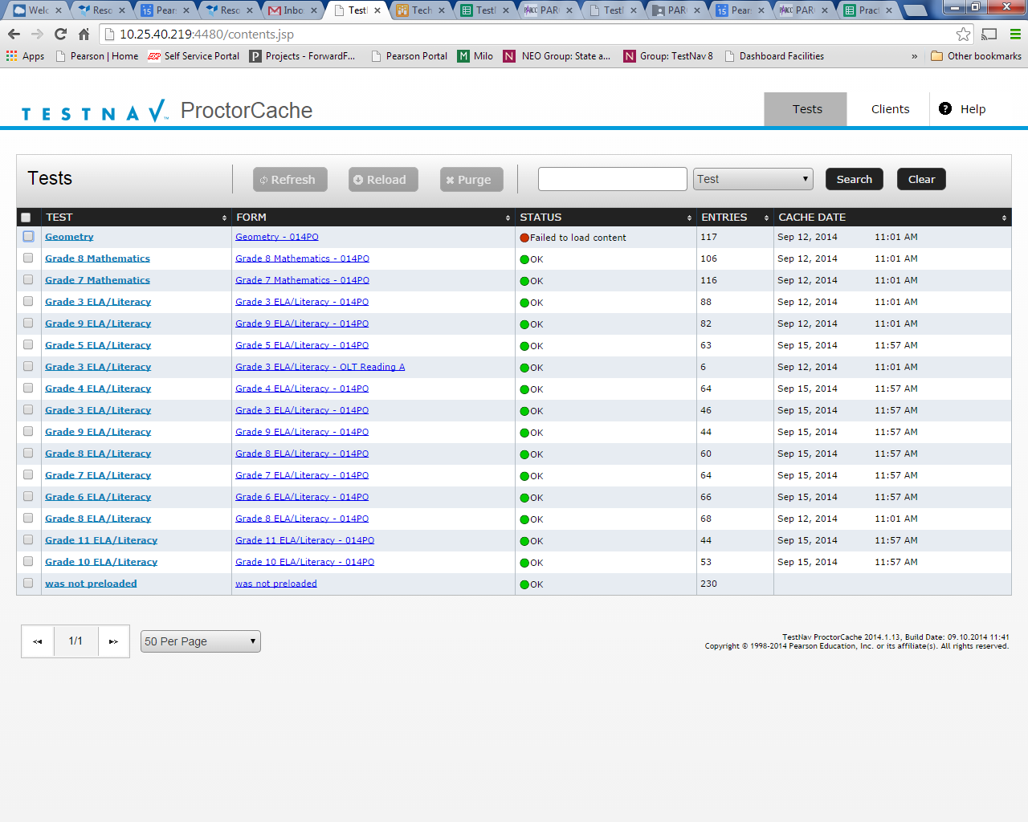
What’s New
User interface redesign and enhancements that include:
renaming the Contents tab to Tests and the Client List tab to Clients for clarity,
consolidating information previously displayed on the Home page into the Clients and Tests tabs,
resolving issues with IE 11 not displaying the list of cached content,
more robust comparison between content on the caching computer and content on the Pearson server to verify the cache has the most up-to-date content, and
renaming the “undefined” directory to “Was not Preloaded” to eliminate confusion.
PARCC recommends that all schools upgrade to latest version to take advantage of these enhancements.
Notes:
What does the new proctor caching software offer?
The user interface has been redesigned to include the following enhancements:
renaming the Contents tab to Tests and the Client List tab to Clients for clarity,
simplifying use by consolidating information previously displayed on the Home page into the Clients and Tests tabs,
resolving issues with Internet Explorer 11 the list of cached content,
enabling more robust comparison between content on the caching computer and content on the Pearson server to verify the cache has the most up-to-date content, and
renaming the “undefined” directory to “Was not Preloaded” to eliminate confusion.
PARCC recommends that all schools upgrade to latest version to take advantage of these enhancements.

Slide 12
Proctor Caching Setup
Download the proctor caching installer.
Run the installer and Start Proctor Caching if it is not already started by the installer.
Use SystemCheck from the client computer to verify that proctor caching is functional.
Create a proctor caching setup or add a proctor caching computer within PearsonAccess Next at the district or school level.
Notes:
To install proctor caching you must....
Download the proctor caching installer.
Run the installer and Start Proctor Caching if it is not already started by the installer.
Use the SystemCheck tool from the client computer to verify that proctor caching is functional.
Create a proctor caching setup or add a proctor caching computer within PearsonAccess^{next} at the district or school level.

Slide 13
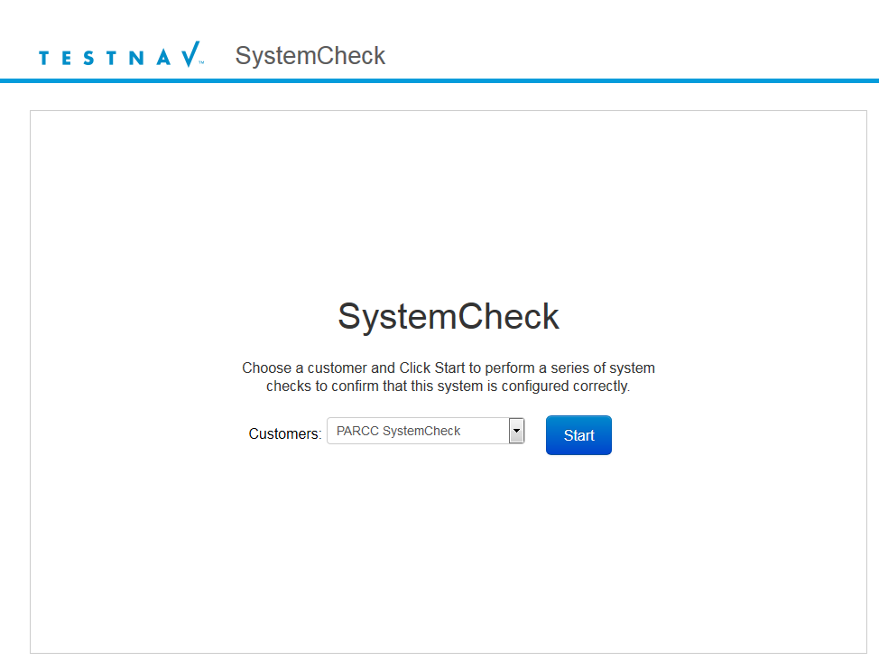
SystemCheck Tool
Notes:
SystemCheck is another resource available to schools to help them prepare for the PARCC computer-based assessments. SystemCheck is designed to help district and local technology personnel to better assess the overall readiness for online testing. The SystemCheck tool requires your computer’s web browser to have JAVA Plugin enabled in order to run.
We will review how to use the SystemCheck Tool and then use it to validate that our Proctor Caching machine is running and functional.
Upon starting the SystemCheck Tool, you will see a screen with a Start button. Click this button to begin.

Slide 14
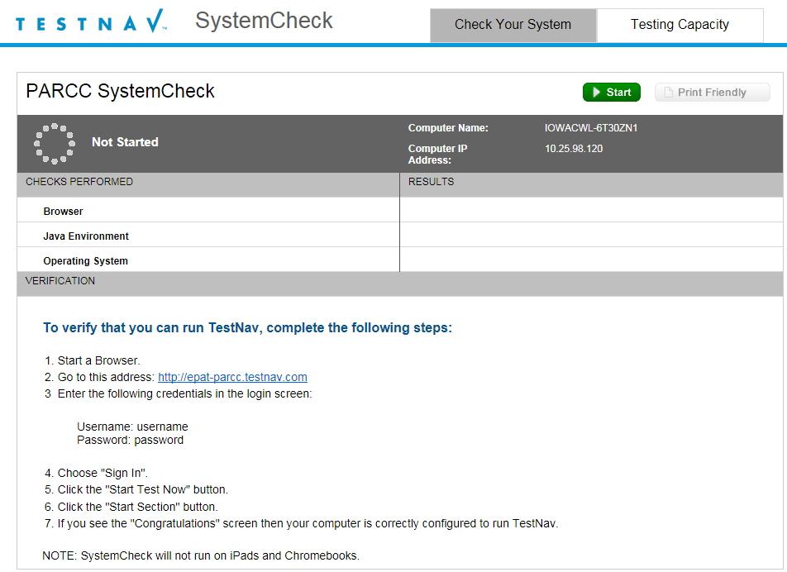
SystemCheck Tool
Notes:
You should see a screen with two tabs load. If this screen does not appear, your web browser may not be configured to run Java applets. If this is the case, you will need to configure your web browser to run Java applets from https://*.testnav.com or go to http://java.com and click on the “Do I have Java?” link to verify that Java is enabled in your browser.
At the Check Your System tab screen, you can click the green Start button to verify your Browser, Java version, and Operating System version. Note that SystemCheck will not run on iPads or Chromebook devices.
The next step is to open a new browser window and follow the directions on the screen to load a demonstration of TestNav.
Once you have completed these steps we can now click on the Test Capacity tab and test our network capacity to load test content.

Slide 15
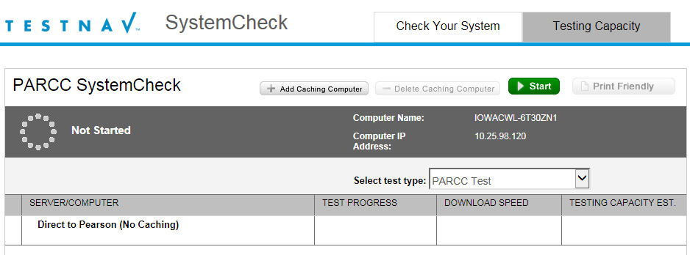
SystemCheck Tool
Notes:
On the Testing Capacity tab, you can use the “Add Caching Computer” button to add your Proctor Caching machine. Note that you can add multiple Proctor Caching machines.

Slide 16
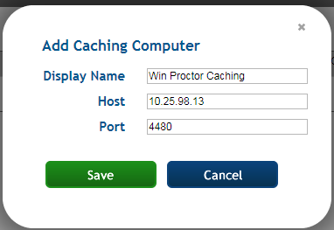
SystemCheck Tool
Notes:
For each Proctor Caching machine, add a Display Name, Host IP Address, and port. The default port for Proctor Caching is 4480. Once you have added each of your Proctor Caching machines, click the green Start button to begin the bandwidth testing.

Slide 17
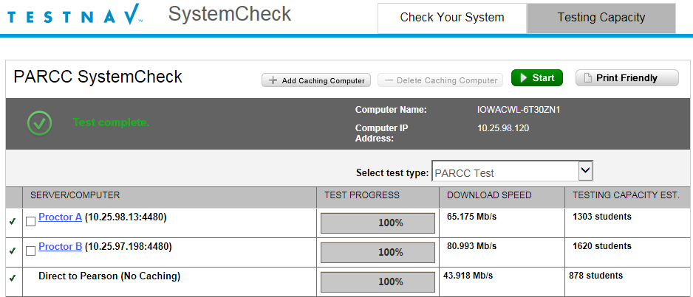
SystemCheck Tool
Notes:
The process will take a few minutes for each Proctor Caching machine being tested, as well as for “Direct to Pearson” connection. Once complete you should see your Download Speed results and an estimation of your testing capacity. Results will vary depending on the network utilization, lab environment, and other factors.

Slide 18
SystemCheck Tool
Demonstration
Notes:
We will now demonstrate the SystemCheck Tool…

Slide 19
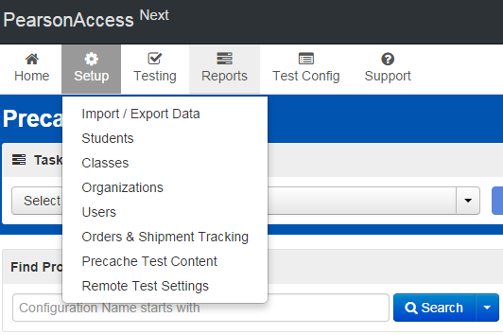
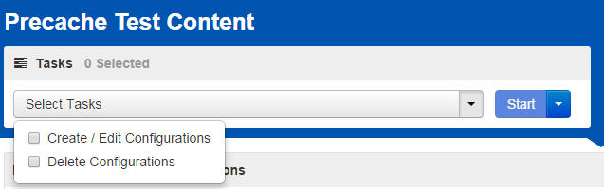
Configure TestNav Setup
Sign in to the PARCC PearsonAccess Next website at http://PARCC.Pearson.com.
Select Setup > Precache Test Content.
Select Create/Edit Configurations; click Start to launch the configuration.
Notes:
Next you will need to create a TestNav configuration. Sign in to the PARCC PearsonAccess Next website. Technology staff will need to receive secure access from their district coordinator.
The Configuration screen can be accessed by selecting Setup and then Precache Test Content from the drop-down menu. This will allow you to access the configurations settings to set primary and secondary temporary student response save locations for TestNav, and if applicable, set up a connection to your proctor caching machine(s).
Select Create/Edit Configurations from the tasks menu to launch the Configuration screen.

Slide 20
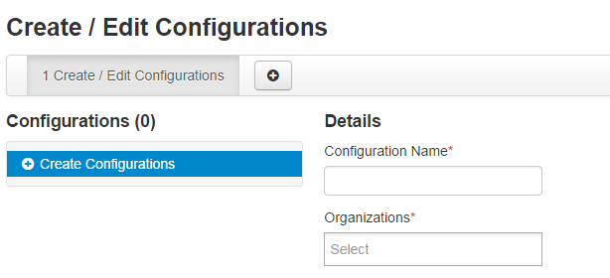
Configure TestNav Setup
Enter a Configuration Name.
Using the Organizations drop-down menu, select your school or district.
Notes:
You will be prompted to name your configuration. Configuration names must be unique within the PARCC PearsonAccess Next website; this prevents confusion by allowing users to distinguish them. Pearson recommends using only letters and numbers in this field, as other characters may cause problems with test delivery. For example, Computer Lab 1 and Computer Lab 2, or High School and Middle School.
Next, using the Organizations drop-down menu, select the appropriate school or district from the menu. Regardless of the organization level, you will have the ability to add multiple settings (and proctor caching machines) to the configuration.

Slide 21
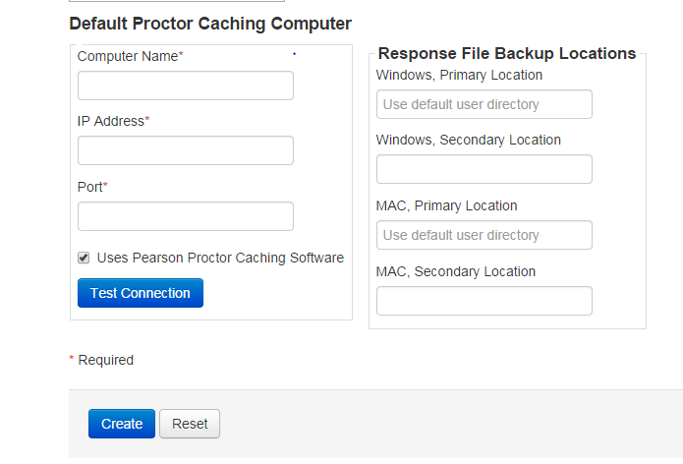
Configure TestNav Setup
Enter the Computer Name, IP Address, Port information, and check “Uses Pearson Proctor Caching Software.”
Then specify student response file backup locations, and click Create.
Notes:
Next, you can identify the proctor caching computer. In the “Default Proctor Caching Computer” section, enter a computer name, the computer’s IP address, and port information.
The computer name will be the name that displays when selecting a proctor caching machine during test session creation. If you will be proctor caching, provide the internal network IP address of the caching machine and the port number, which is 4480 for Pearson-supplied proctor caching. The IP address should be a static address to ensure students can access content during testing. Also note, the computer selected for proctor caching should not be a student testing machine.
Check “Uses Pearson Proctor Caching Software.”
If you will be using a non Pearson-supplied caching solution, you will uncheck the box next to “Uses Pearson proctor caching software” and make sure the port is the correct port for the caching solution you will be using.
If you will not be proctor caching, simply leave the IP Address and Port fields blank; you will still need to complete the next steps for TestNav. ***NEEDS VALIDATION***

Slide 22
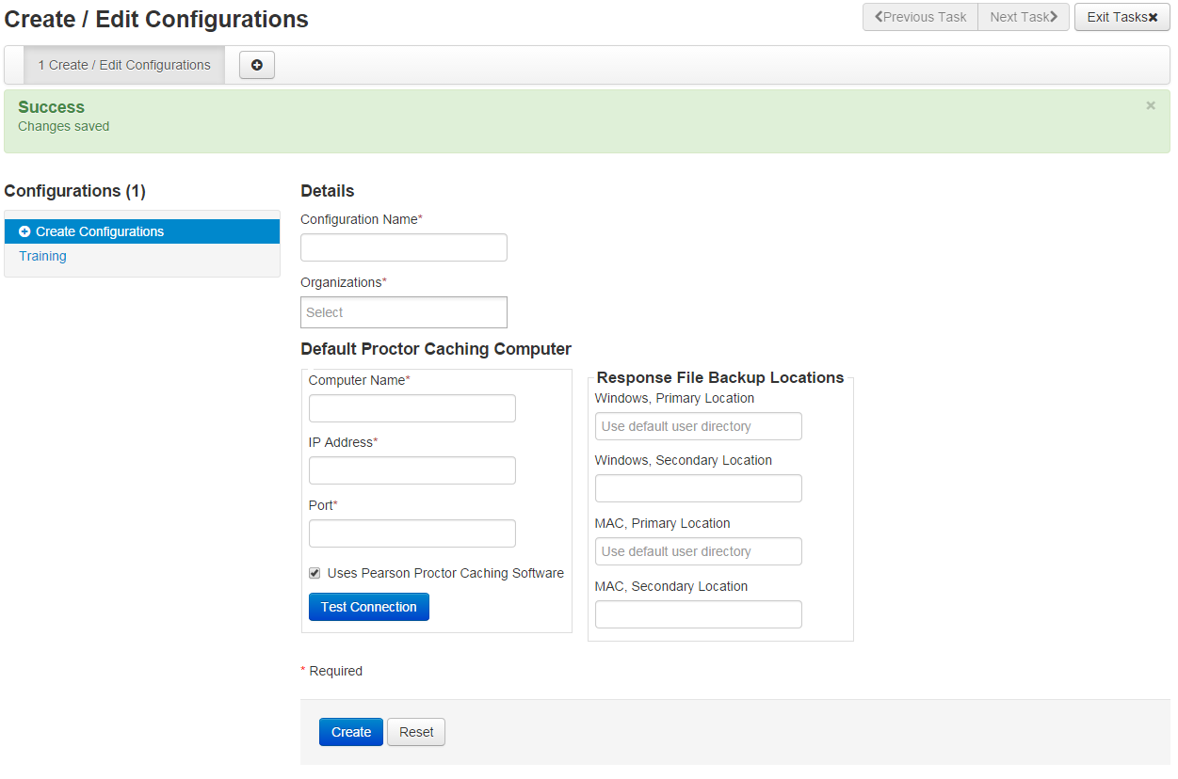
Completed TestNav Configurations
Notes:
A green Success! message will display after successful configuration. A red error will appear if there are issues.
To view, add, or make changes to an existing configuration, click on the configuration name under “Configurations.”

Slide 23
Configure TestNav Setup
Demonstration
Notes:
We will not demonstrate how to add a configuration.

Slide 24
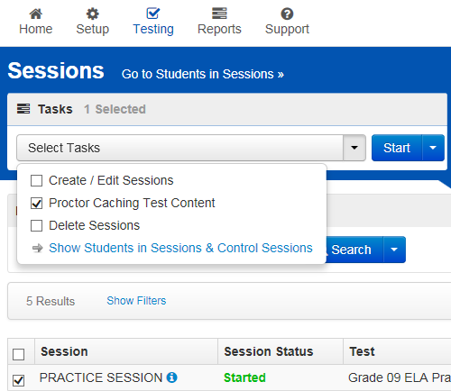
Precaching Content
Choose Sessions under the Testing tab
Select “Proctor Caching Test Content” from the Tasks menu and click Start
Notes:
Proctor Caching test sessions can be done by choosing Sessions under the Testing tab. On the Sessions screen, search for the sessions that you would like to Proctor Cache or use Search arrow to select “Show all results” to bring up all sessions in your organization.

Slide 25
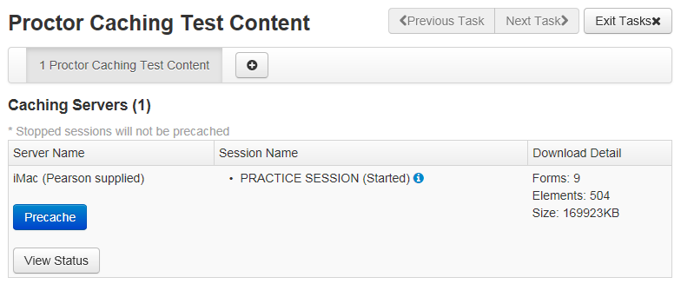
Precaching Content
Click the Precache button on the Proctor Caching Test Content screen
Notes:
This will bring up the “Proctor Caching Test Content” screen. On this screen you can click the Precache button to Proctor Cache the session. You can also click the “View Status” button to bring up the Proctor Caching Interface for the specified machine listed.

Slide 26
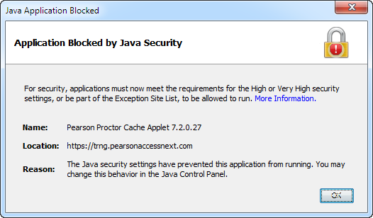
Precaching Content
Your Web Browser is not configured to run Java applet.
Notes:
Your web browser may not be configured to run Java applets. If this is the case, you might see an error message similar to this one pop-up on your screen. Please configure your web browser to run Java applets from https://*.pearsonaccessnext.com or go to http://java.com and click on the “Do I have Java?” link to verify that Java is enabled in your browser.

Slide 27
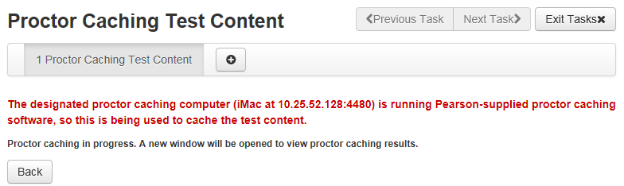
Precaching Content
Proctor caching is in progress…
Notes:
This message will appear once you have clicked the Precache button. You will need to click the Back button to return the “Proctor Caching Test Content” screen.

Slide 28
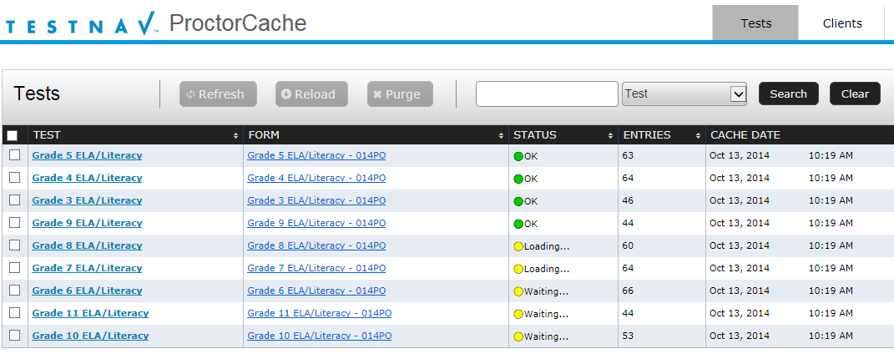
Precaching Content
Proctor Caching - Tests Screen will appear in a second window.
Notes:
Depending on your browser, a second tab or window will appear shortly. This window will display the Proctor Caching – Tests tab. It will detail each Test, Form, and status.

Slide 29
Precaching Content
Demonstration
Notes:
We will now demonstrate this workflow.

Slide 30
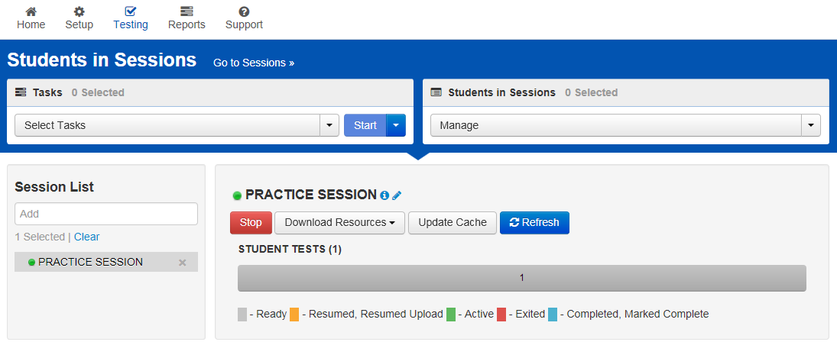
Precaching Content
Update Cache from the Students in Sessions screen under the Testing tab.
Notes:
You can also Proctor Cache sessions by using the “Students in Sessions” screen. You can bring this screen up by choosing Students in Sessions under the Testing tab. Selecting a session in the Session List to the right, will allow you to Proctor Cache the session by then clicking the “Update Cache” button.

Slide 31
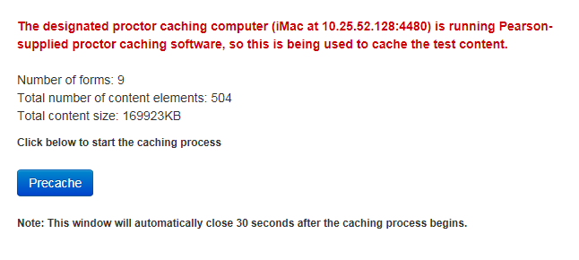
Precaching Content
Click Precache button to initiate the caching process.
Notes:
This will bring up a popup window with a similar Precache button, that will allow you to initiate the caching process. The popup window automatically closes after you click the Precache button. A second tab or window will appear shortly. This window will display the Proctor Caching – Tests tab.

Slide 32
Precaching Content
Demonstration
Notes:
We will now demonstrate this workflow.

Slide 33
Test Preparation
Practice Testing in the PearsonAccess^{next} Training Site
Students can utilize the Sample Items, TestNav 8 Tutorial, and Practice Tests available under the Test Preparation area of http://parcc.pearson.com
Notes:
Practice tests are a critical step in supporting students’ and schools’ transitions to new assessment content. Practice tests were developed so students and staff can have a hands-on experience with the test environment and items for the 2014-2015 PARCC assessments.
STCs, especially new ones, need to the experience of setting up and delivering a test in PearsonAccess^{next} and the best place to practice this is in the Training site. Then that practice test needs to be administered on the devices that will be used for the operational assessment. Students will now get the experience of taking an online assessment, learn how to navigate the user interface, use the tools and accessibility features, and STCs learn how to administer an online assessment in a safe, practice environment. Training site practice test content can be proctor cached, and because of this, districts can confirm the functionality of Proctor Caching.

Slide 34
Infrastructure Trial
An Infrastructure Trial is an opportunity for LEAs, schools, and students to prepare for the computer-based PARCC Test by simulating test-day network utilization.
The Infrastructure Trial should take approximately 60 minutes to administer. Schools are encouraged to provide any feedback on the Infrastructure Trial to LEAs. LEAs should contact your State PARCC Test Lead with feedback and/or concerns regarding software or hardware issues.
Notes:
An Infrastructure Trial is an opportunity for LEAs, schools, and students to prepare for the computer-based PARCC Test by simulating test-day network utilization. This will help to determine any school or LEA issues, and confirm all testing devices are properly configured and ready to run PARCC assessments. The Infrastructure Trial also provides an opportunity to introduce students to the TestNav testing interface through the online test content. Unlike a live assessment, you will not use real student information; instead you will create sample students in the PearsonAccess^{next} Training site at http://parcc.pearson.com/pearsonaccess/. Student responses are neither captured, nor saved when they interact with TestNav as part of the Infrastructure Trial process.
The Infrastructure Trial should take approximately 60 minutes to administer. Schools are encouraged to provide any feedback on the Infrastructure Trial to LEAs. LEAs should contact your State PARCC Test Lead with feedback and/or concerns regarding software or hardware issues.

Slide 35
Infrastructure Trial
Who should be involved?
You should involve all LEAs and school personnel responsible for participating in a computer-based assessment. It provides the opportunity to collectively evaluate the test environment and identify and resolve potential issues prior to the PARCC Test. For example, you would want to include:
  Test Coordinators
  Test Administrators
  LEA and school technology staff
  Students
Notes:
Conducting an Infrastructure Trial provides the school with a scheduled opportunity to practice in a low-stakes environment that can help identify possible problems and avoid delays during administration of the PARCC Test. You should involve all LEAs and school personnel responsible for participating in a computer-based assessment. It provides the opportunity to collectively evaluate the test environment and identify and resolve potential issues prior to the PARCC Test. For example, you would want to include:
Test Coordinators
Test Administrators
LEA and school technology staff
Students

Slide 36
Infrastructure Trial
Where to start:
The Infrastructure Trial is conducted using the PearsonAccess^{next} Training site at http://parcc.pearson.com/pearsonaccess/.
You should first check with your LEA to see if the Infrastructure Trial will be performed from a district or school level. Then, you will need to verify that all staff members participating in the trial have received user IDs and passwords for the PearsonAccess^{next} Training site.
Refer to the PARCC Infrastructure Trial Readiness Guide for complete instructions.
Notes:
The Infrastructure Trial is conducted using the PearsonAccess^{next} Training site at http://parcc.pearson.com/pearsonaccess/. You should first check with your LEA to see if the Infrastructure Trial will be performed from a district or school level. Then, you will need to verify that all staff members participating in the trial have received user IDs and passwords for the PearsonAccess^{next} Training site with appropriate permissions.
Refer to the PearsonAccess^{next} Training module for more information on creation user IDs. For complete instructions on completing the Infrastructure Trial refer to the PARCC Infrastructure Trial Readiness Guide.

Slide 37
PearsonAccess^{next} Setup
Schools or Districts will need to complete the following in PearsonAccess^{next} prior to the Infrastructure Trial:
Create Sample Students
Create Sessions
Print Student Testing Tickets and Unlock Codes
Notes:
Once TestNav and Proctor Caching configurations have been added to PearsonAccess^{next}, the next set of tasks can be completed by school personnel:
Sample Students can be created in the PearsonAccess^{next} Training site in order to administer an Infrastructure Trial.
Online Testing Sessions will then be created.
And from each session print Student Testing Tickets, Session Unlock Codes, and Rosters may be printed in preparation for the Infrastructure Trial.
We will now demonstrate each of these tasks.

Slide 38
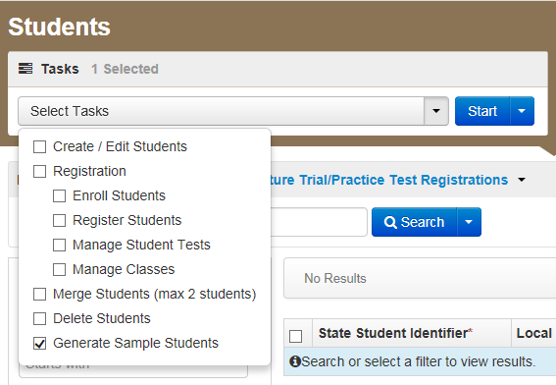
Create Sample Students
Log into the PearsonAccess^{next} Training Site
Choose Spring PBA or EOY 2015 Administration
Click Setup and select Students
Select Generate Sample Students from the Tasks menu
Click Start to continue
Notes:
To begin, we will log into the PearsonAccess^{next} Training Site. We will then choose the either the Spring PBA or EOY Administration. Infrastructure Trial testing is only available in either of these two administrations.
To Create Sample Students:
On the PearsonAccess^{next} home page, click Setup, select Students from the menu.
Next, select Generate Sample Students from Tasks menu; click Start to continue.

Slide 39
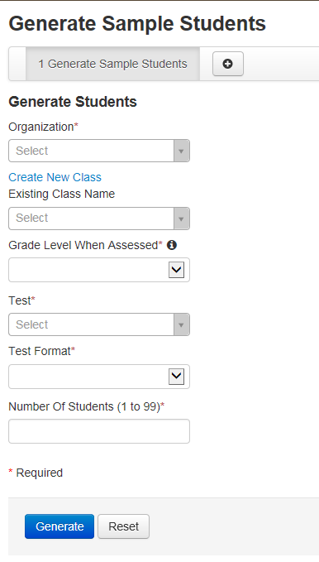
Create Sample Students
Complete the Generate Sample Students screen
Click Generate to complete the process
Notes:
You will need to complete these fields:
Organization: Select your school/organization
Class: Add an Existing Class Name or you may choose to create a new class
Grade Level When Assessed
Test: Choose one of the Practice Tests available from the pull down menu.
Test Format: Select Online for this option
Number Of Students: input a number between 1 through 99.
Click Generate
A confirmation screen will appear once the sample students have been created
Repeat the steps above until you have created sample students for the number of testing devices that will be tested concurrently, plus at least 10% additional sample students.

Slide 40
Create Sample Students
Demonstration
Notes:
We will now demonstrate the process once more.

Slide 41
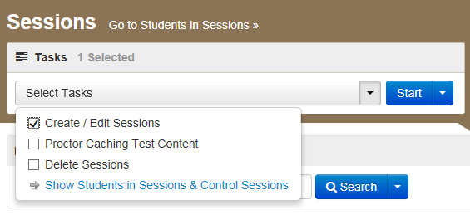
Create Sessions
Go to the Testing tab and click Sessions
From the Select Tasks pull-down menu select Create/Edit Sessions and click Start
Notes:
In the Training site, go to the Testing tab and click Sessions.
From the Select Tasks pull-down menu select Create/Edit Sessions and click Start.

Slide 42
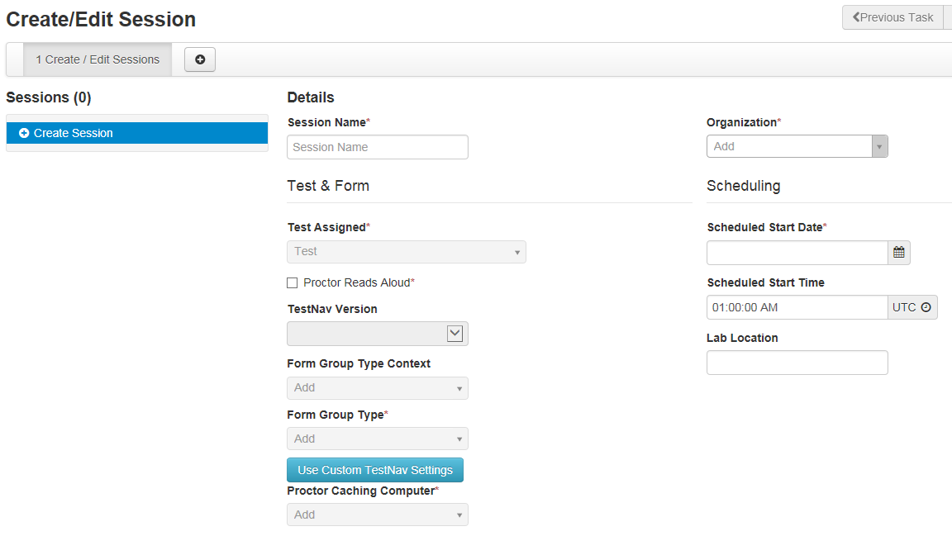
Create Sessions
Complete Test Details
Notes:
Complete the test session details by entering the Session Name and selecting the Organization (School or District) from dropdown menu.
Next, complete the Test & Form section. Select Test Assigned and choose the appropriate Practice Test from the dropdown.
Form Group Type to be set to “Main”.
If Proctor Caching select Proctor Caching Computer from drop down menu.
Then, enter Scheduled Start Date in Scheduling section.
Scheduled Start Time and Lab Location are not required fields but it is recommended to complete both.
Note: The Scheduled Start Date and Scheduled Start Time for a session are intended primarily for planning purposes, it is not enforced. A test session will not be started until you click Start on the Session Details screen, regardless of the scheduled start date and time.

Slide 43
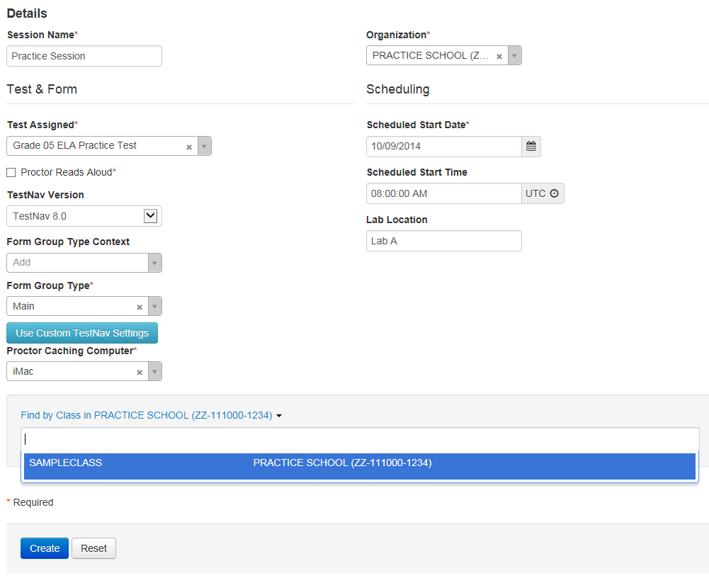
Create Sessions
Complete Test Details
Notes:
Finally add students assigned to this session, click Create.
Note: you can add individually by name or id association or in bulk using the class option. To add students by class, select the Find by Class button and select the class containing the sample students you would like to add to the session.
Click Create to create the session. A confirmation message will be displayed once the session has been successfully created.

Slide 44
Create Sessions
Demonstration
Notes:
We will now demonstrate the process once more.

Slide 45
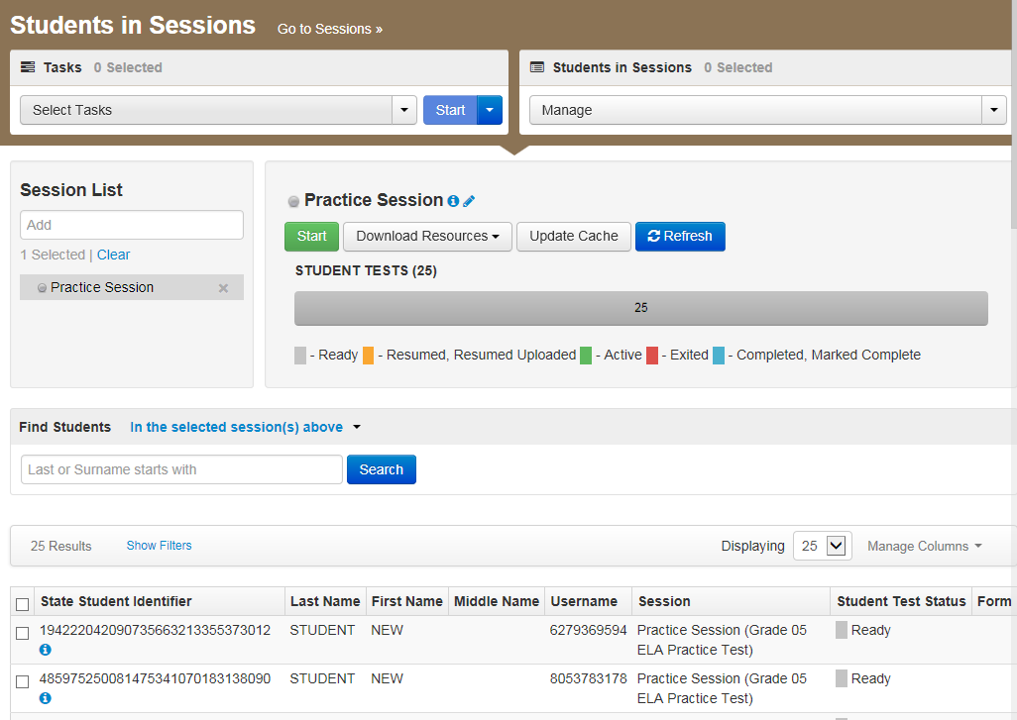
Session Management
Starting Session
Notes:
Now that we have created a session with sample students, we will now need to work with sessions.
To view sessions go to the Testing tab and click Students in Sessions.
Click the session name from the Session List. The Session Details screen will appear for the test session selected. If multiple sessions are selected, the option to Combine View appears.
Click the green Start in the Session Details screen. If multiple sessions are selected and are combined, there is an option to start all sessions.
A confirmation page will be displayed once the session has been started successfully.

Slide 46
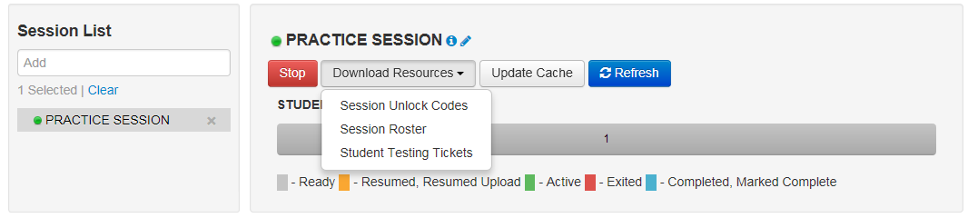
Session Management
Conducting Session
Notes:
Once the session is started, the Start button will change to a Stop button to allow you to Stop a session.
Use the Download Resources pull-down menu to view and print:
Session Unlock Codes
The Session Roster
and Student Testing Tickets
The Update Cache button may be used to update the Proctor Caching machine’s test content.
The Refresh button can be used to update the screen if needed.

Slide 47
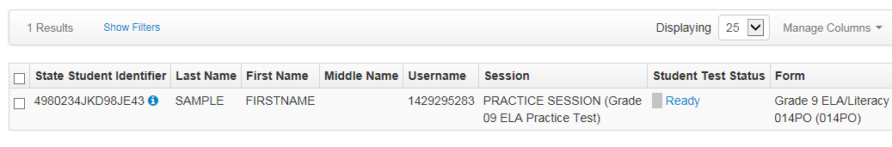
Session Management
Student Test Status Key
Notes:
The Student Test Status will change individually for each student. The different color codes status are displayed in the Session window for your benefit. The individual students are displayed below along with their individual Student Test Status and other information.
Status key includes:
Ready - The student has not logged in to the session yet, but is ready to log in
Resumed, Resumed Upload - The student is ready to log back in to the session or the student is ready to log back in to the session and some responses were not sent to Pearson servers before exiting. Students will be prompted to have saved responses uploaded before resuming the test.
Active - The student is currently in the test.
Exited - The student has exited the session, but has not submitted his or her responses yet. Students in Exited status will need to be resumed by a Test Administrator to re-enter the test
Completed, Marked Complete - The student has completed the test and has successfully submitted his or her responses or the student’s test has been marked complete by the Test Administrator rather than being submitted through TestNav.

Slide 48
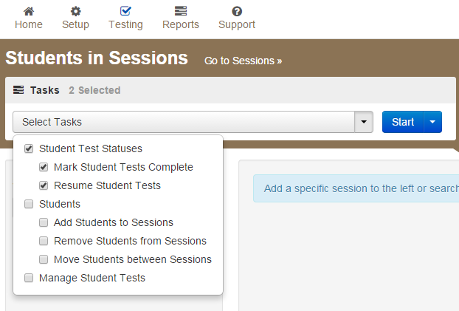
Session Management
Resuming, Marking Students Complete
Notes:
Once a session has been started, there are a number of actions that may need to be carried out in order to complete the Infrastructure Trial. These actions include resuming sample students, resuming sample students with saved responses, and marking tests complete. The Test Administrator should have their own device to perform these actions.
To mark test complete, resume student tests or undoing student test submissions, go to Testing tab, select Students in Session. Be sure the session name is selected within Session List. Check box next to student(s) name. Select from menu action you would like to complete.
To stop session, select the red stop button located on Student sessions. Please note, all students must be marked complete before stopping a session. You may also need to remove any students left in “Ready” status to successfully stop a session.

Slide 49

Infrastructure Trial
Ready to Begin Your Infrastructure Trial?
Technology Set-up Complete
Practiced with sample items and Practiced Tests
PearsonAccess^{next} Training site setup has been completed and student testing tickets have been printed.
Reviewed Infrastructure Trial Guide
Notes:
Are you ready to begin your Infrastructure Trial?
Be sure technology set up is complete by:
Verify you have prepared devices by configuring internet firewalls, content and spam filters
If using Proctor Caching, steps to install and run Proctor Caching are complete,
Also, verify SystemCheck was run and devices meet technology requirements and the testing capacity has been estimated.
If using iPad, or Chromebook, confirm the app has been properly configured and is ready for testing
Be sure test sessions have been created and if applicable content is cached and set for infrastructure trial
Perform a small scale preliminary trial with school technology staff without student participation prior to full scale infrastructure trial.
Next, become acquainted with sample items and practice tests.... ADD DETAIL
Once PearsonAccess^{next} has been configured and steps are complete
Print student testing tickets. Testing tickets contain login information for each student to successfully log into the infrastructure trial.
Finally, review the Infrastructure Trial Guide to verify all steps have been completed and you are ready to implement the trial. It is also helpful to have reviewed training modules on PARCC’s Training Management site related to Proctor Caching and SystemCheck – OTHERS?

Slide 50

Infrastructure Trial
What to do during the Infrastructure Trial
  Prepare
  Conduct
  Closing & Lessons learned
Notes:
The Infrastructure Trial should be a coordinated effort by LEA/District personnel, School personnel, and Technology staff. Communication planning is essential to having a successful test administration. Everyone involved should understand their role, know how to contact technology staff and PARCC Support as needed. Technology staff should be ready to monitor their network capacity and track technical issues.
Conduct a lessons learned meeting to document any challenges or concerns that happened during the Infrastructure Trial. Determine important feedback regarding software or hardware issues and communicate these concerns to your state’s PARCC Test lead.
Utilize the Appendixes in the Infrastructure Trail Guide to assist you with all stages of the Infrastructure Trial. The appendixes outline helpful steps for preparing, conducting and closing infrastructure trial.

Slide 51
Questions?

Slide 52
Thank You!

