Slide 1

Measures of Academic
Progress
An Introduction to the MAP® K – 12 Computer Adaptive Interim Assessment

Slide 2

Staff
“Family” Feud
Topic: What is PARCC Missing?
(Provided by Audience)
Staff Development
Differentiate (Instruction/Test)
Timely Results
Inform Instruction
Goal Setting
Grouping
Measure Growth
Intake / Placement

Slide 3


250
How Adaptive Tests Work
240
235
230
Advance
220
Item Difficulty (RIT)
210
Proficient
200
193
190
180
Test Questions
Right answer
Wrong answer
Standard error

Slide 4
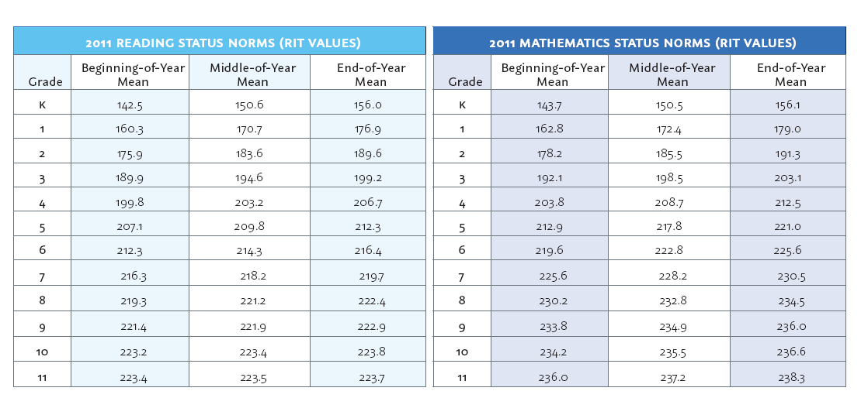
RIT Scale Norms

Slide 5
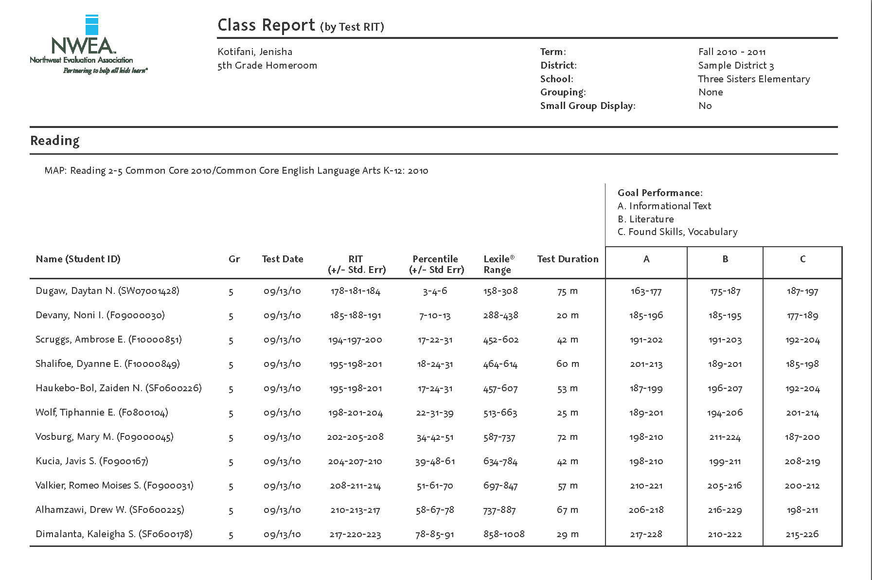

Slide 6
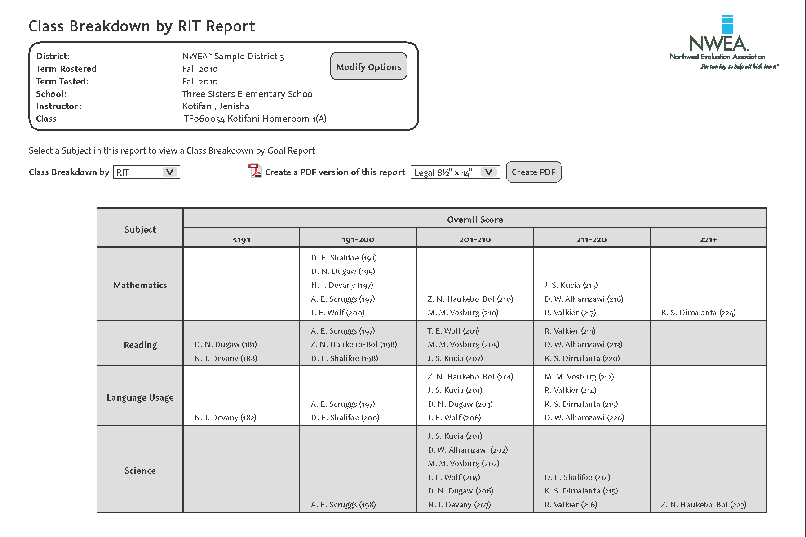

Slide 7
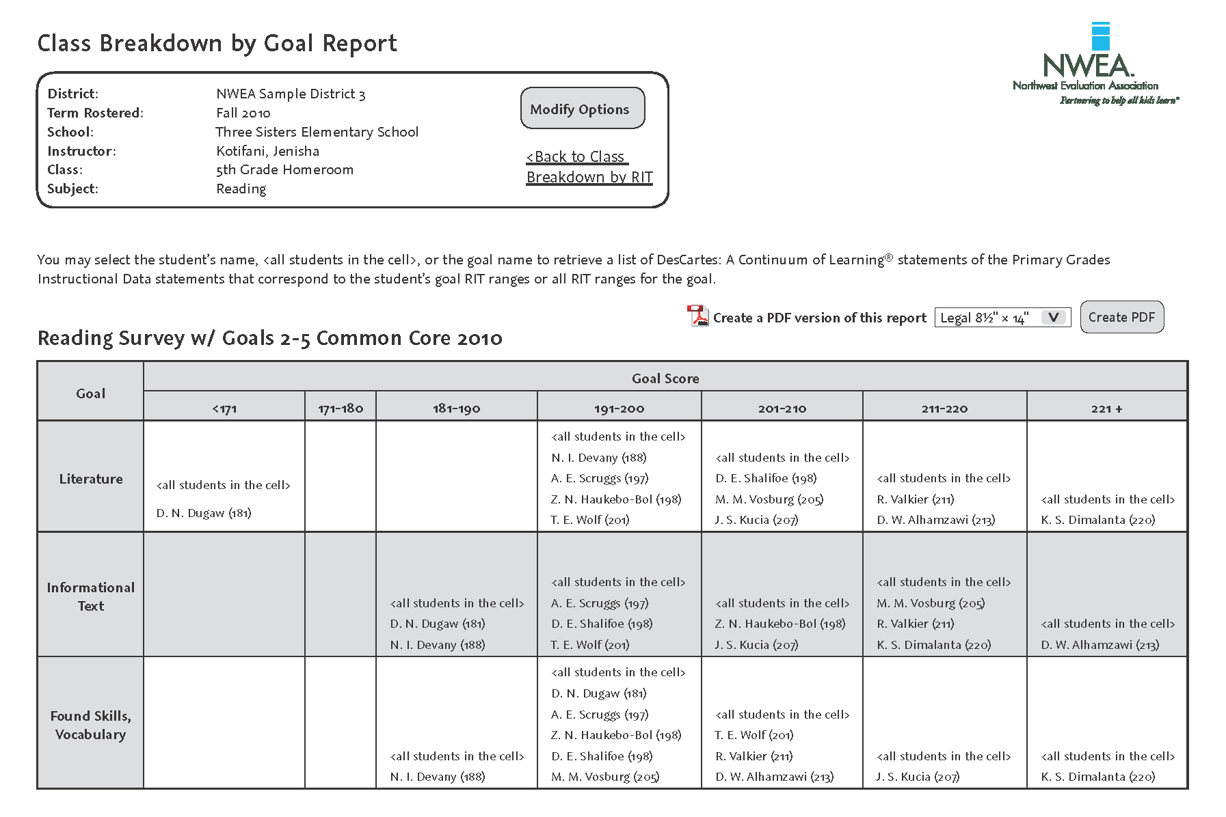

Slide 8
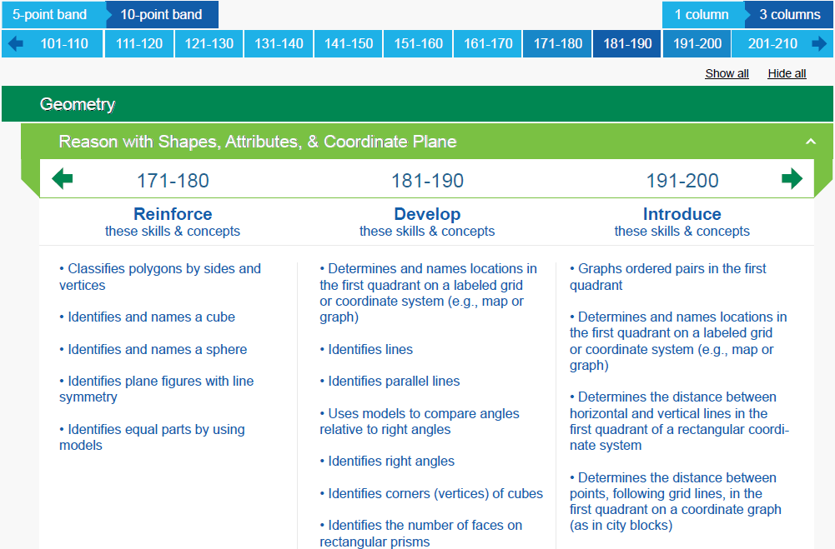

Slide 9
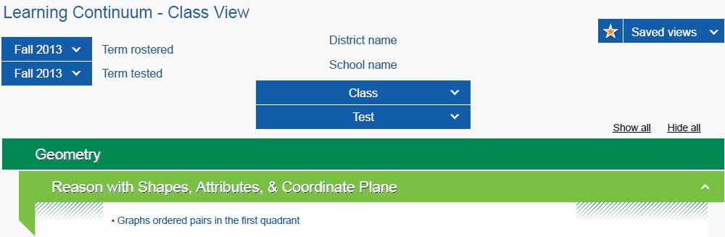
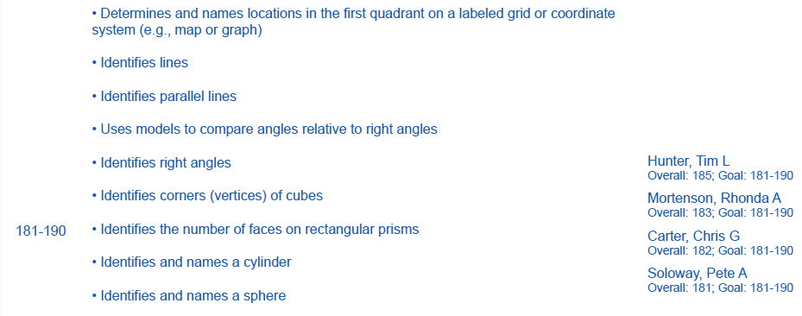

Slide 10

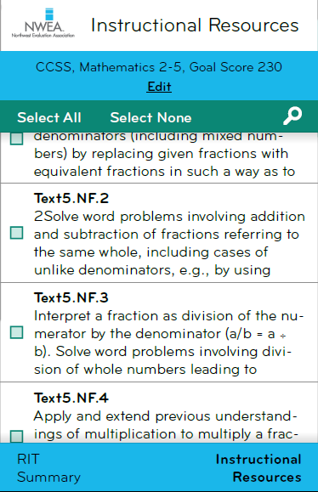
RIT to Resource App
Provides access to millions of free online instructional and learning resources aligned to the Common Core
Content searchable by Common Core standard or MAP goal area
Share specific instructional resources with the others

Slide 11







Instructional Content Providers
Leverage MAP data to provide optimized learning paths for each student
Flexible
Maximize value of district investments
Notes:
MAP only. Not MPG

Slide 12
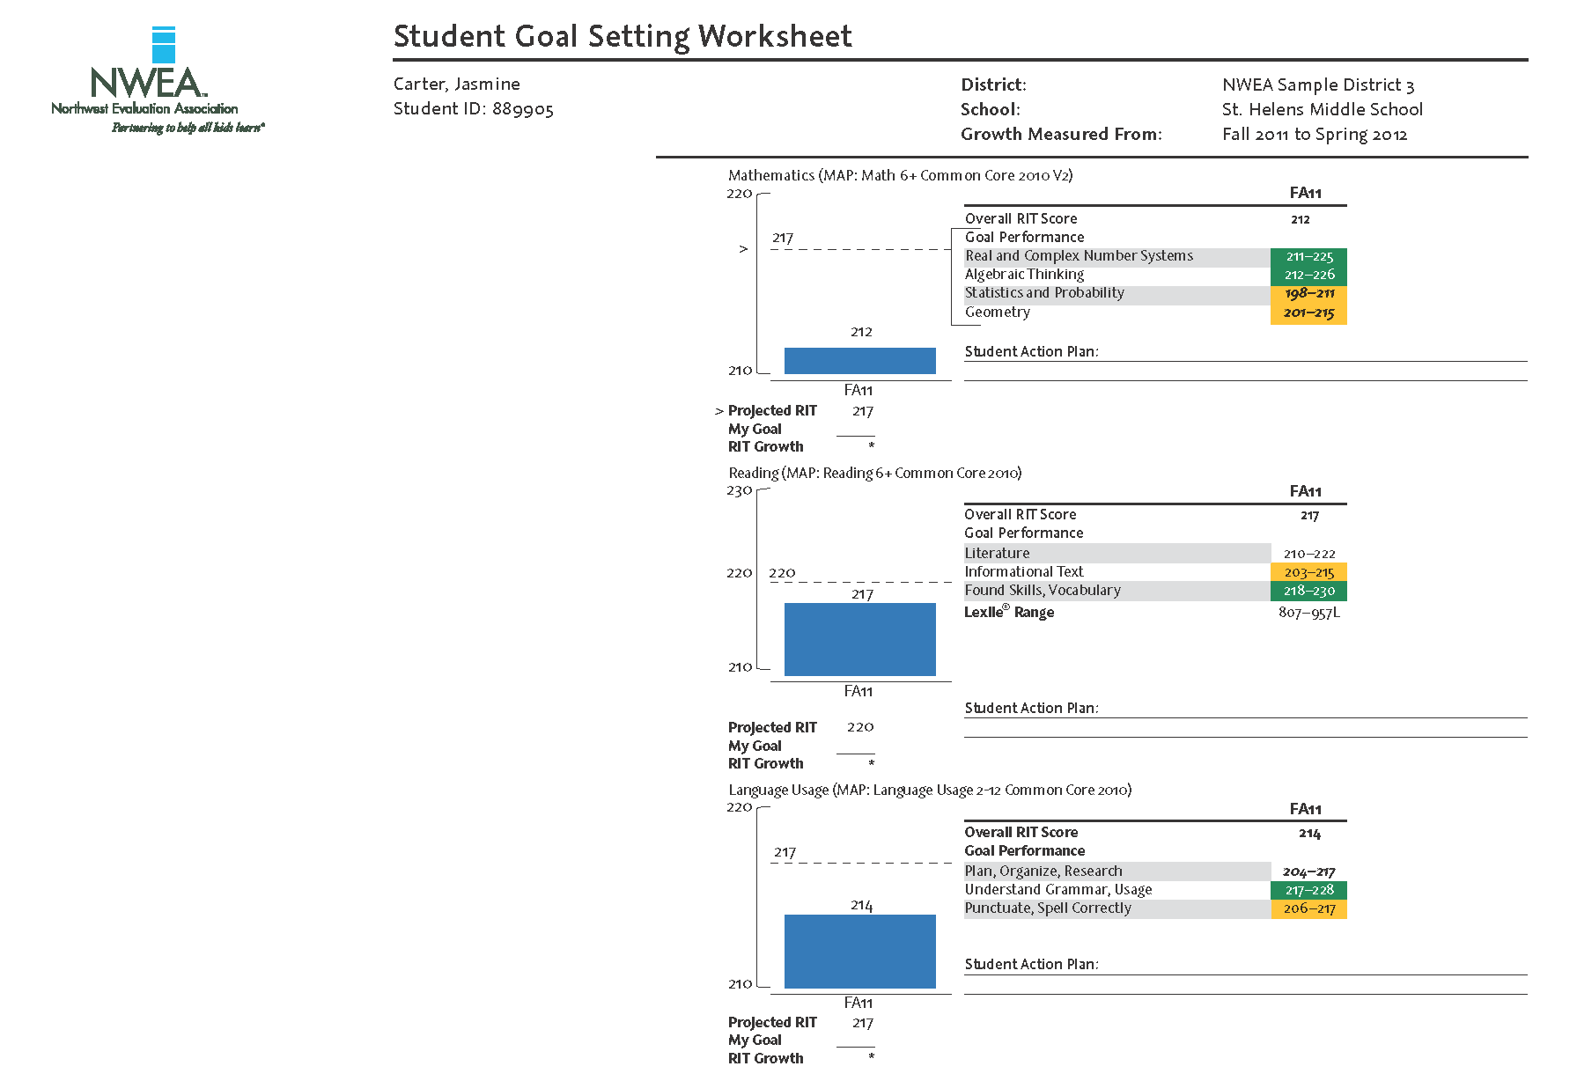

Slide 13
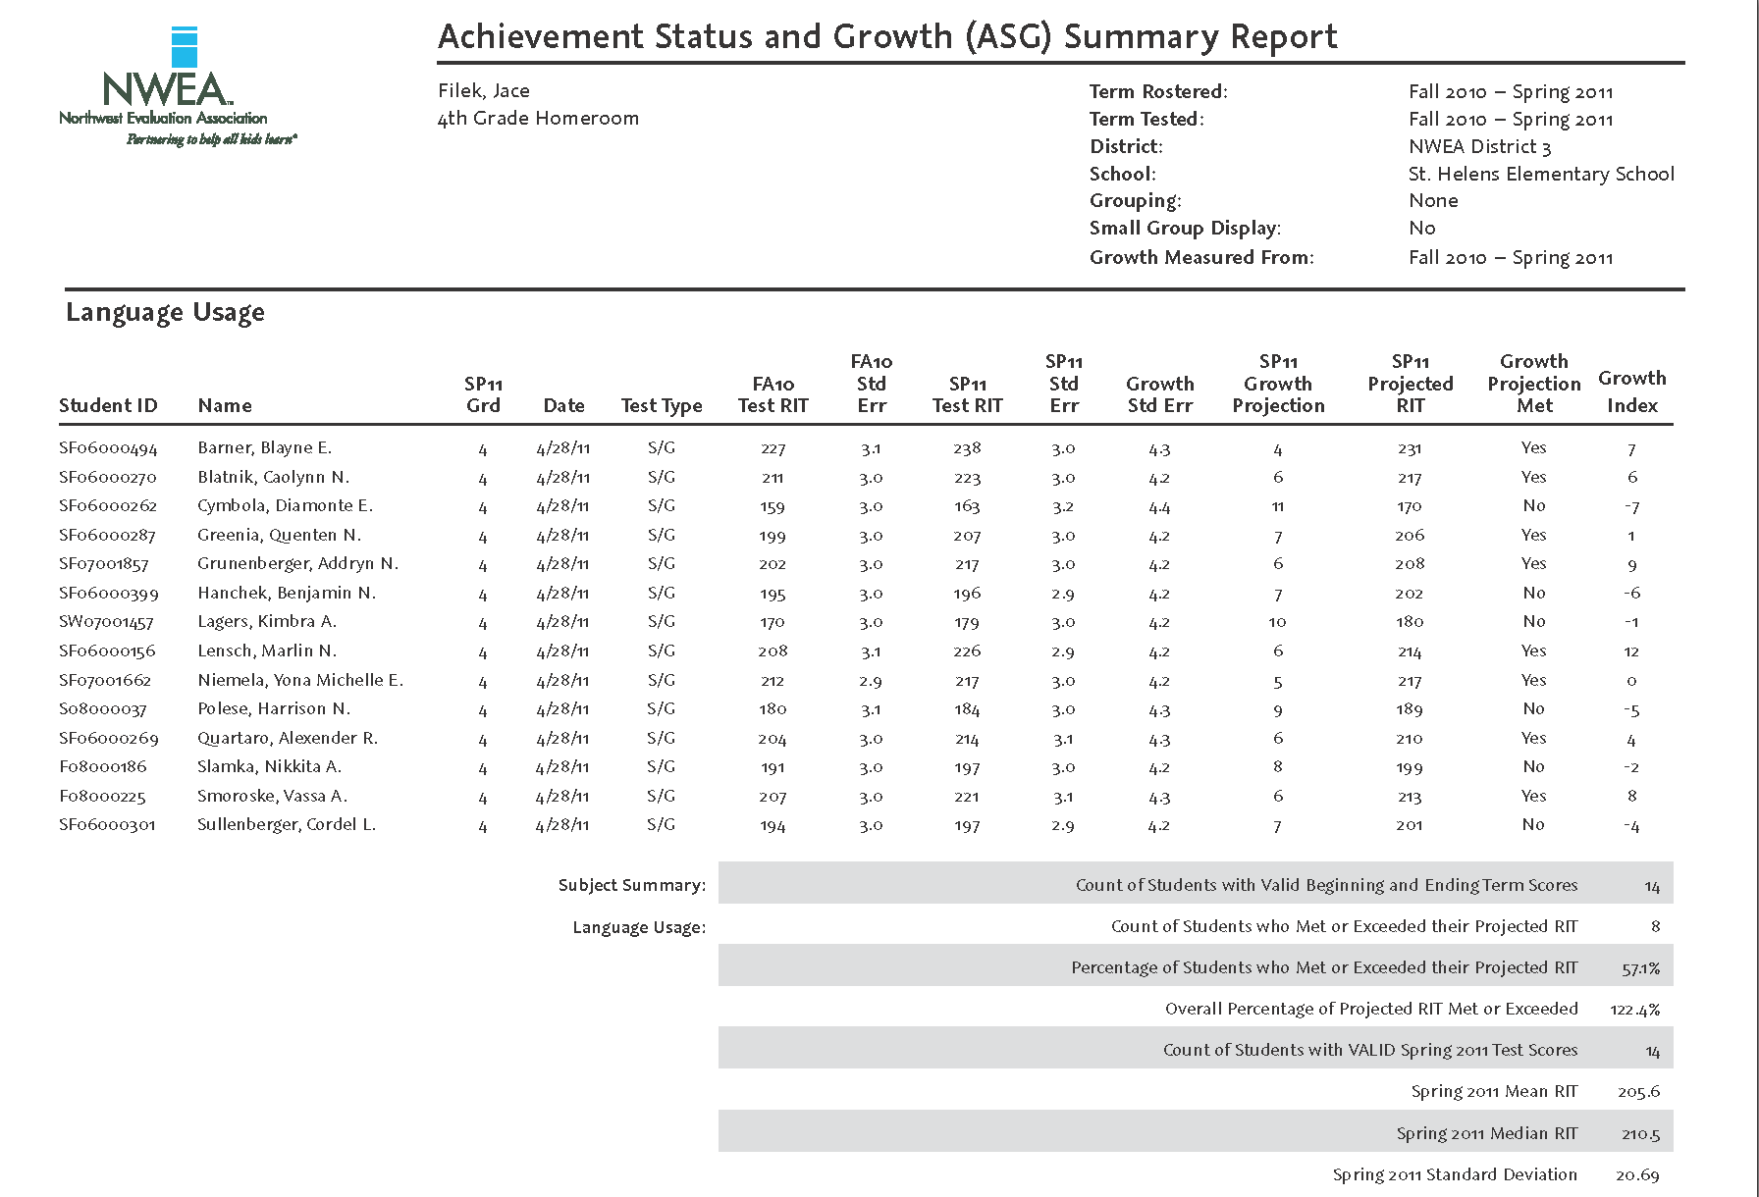

Slide 14
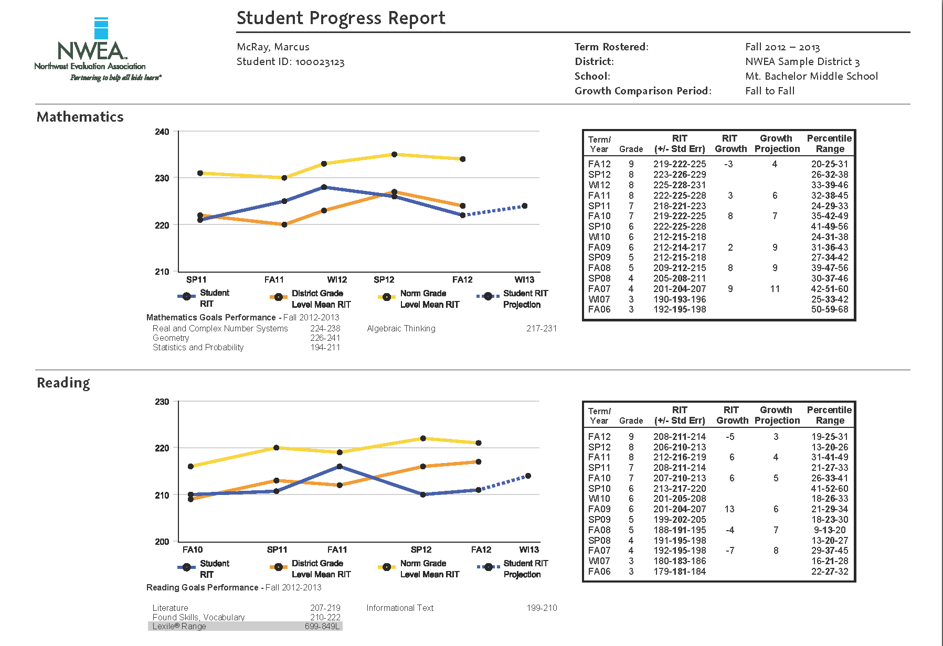

Slide 15
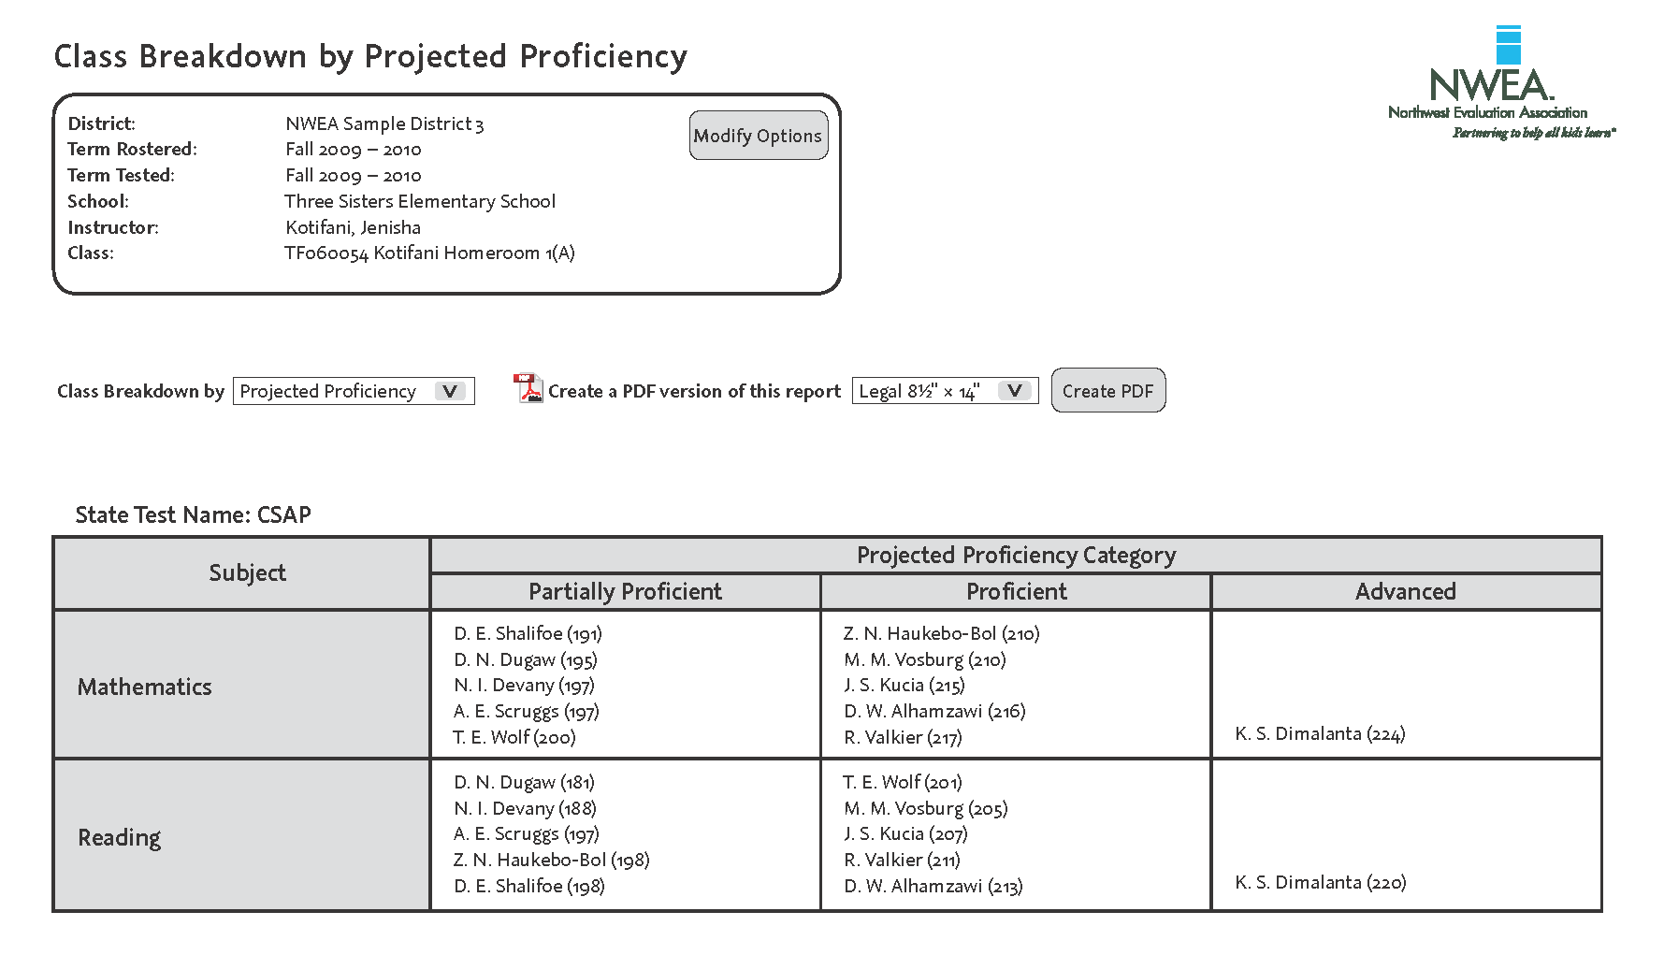

Slide 16
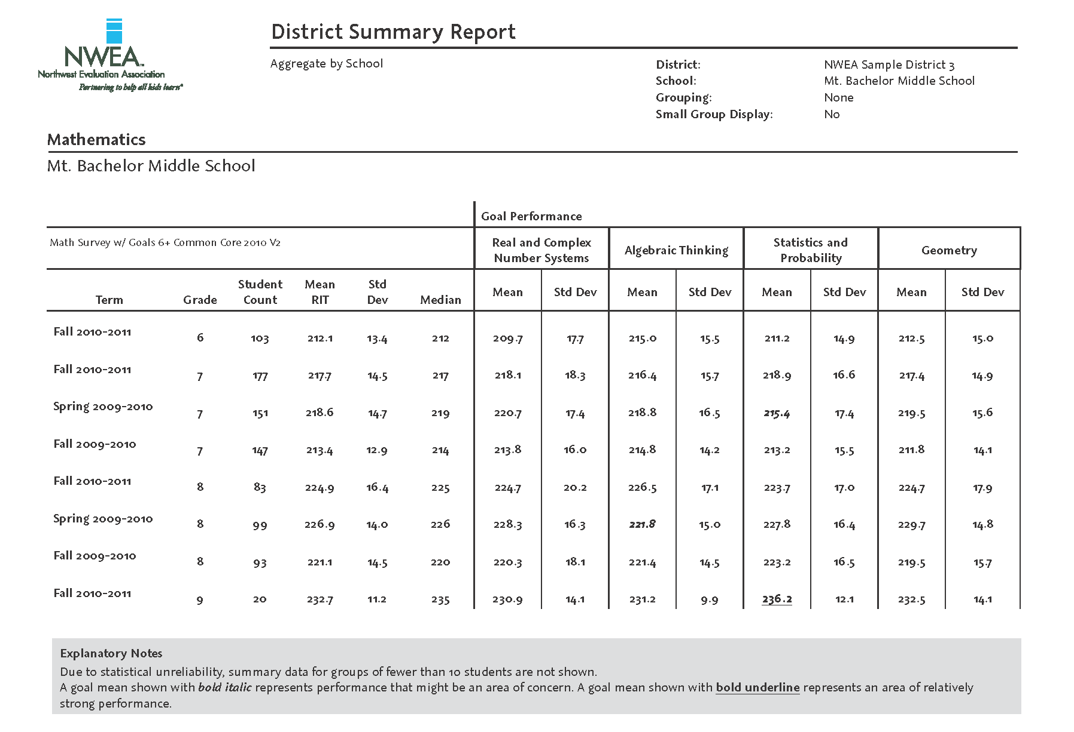

Slide 17

Overview: The MAP Difference
Instructional level vs. mastery
Growth vs. proficiency
Adaptive vs. fixed form
Multiple data points vs. one end of year test
Immediate results vs. waiting for scores
K-12 vs. select grades
Plus:
* Lexile
* Link to lesson systems
* College readiness projection
* MD Common Core aligned

Slide 18

Thank you!
Jim Tilghman
jim.tilghman@nwea.org
260-432-3963

