Slide 1
PARCC Next Generation
Online Assessments:
Opportunities, Challenges, and
Lessons Learned from the 2014 Field Test
MAG 2014
Dale Cornelius, Project Manager
Maryland State Department of Education

Slide 2
Maryland’s History With Online Testing
National Leader in online testing: online since 2007
All MD state tests (except MSA math) have been offered online for years.
MD was one of first states to use Technology-Enhanced Items on a high-stakes assessment (MSA Science).
MD helped lead effort to develop accessibility and interoperability standards for online testing systems (known as APIP), adopted by many states, non-profits, and private companies.

Slide 3
The 2014 PARCC Field Test
MD was only state to test in every school (7 schools unable to participate)
Half of the schools tested online (1 or more groups)
PARCC Field Tests Administered in Maryland | Online | Paper
 | 65,122 | 33,154

Slide 4
PARCC: Opportunities and Challenges
Part I: New Accessibility and Accommodations Options
Part II: New Item Types: Technology Enhanced Items
Part III: New Modes of Delivery
Part IV: Creating Digital Equity in Schools

Slide 5
Part I
New Accessibility and Accommodations Options

Slide 6
New Accessibility Features
On PARCC technology-based assessments, accessibility features are tools or preferences that are either built into the assessment system or provided externally by test administrators.
Accessibility features can be used by any student taking the PARCC assessments (i.e., students with and without disabilities, gifted students, English learners, and English learners with disabilities).
Since the accessibility features are intended for all students, they are not classified as accommodations

Slide 7
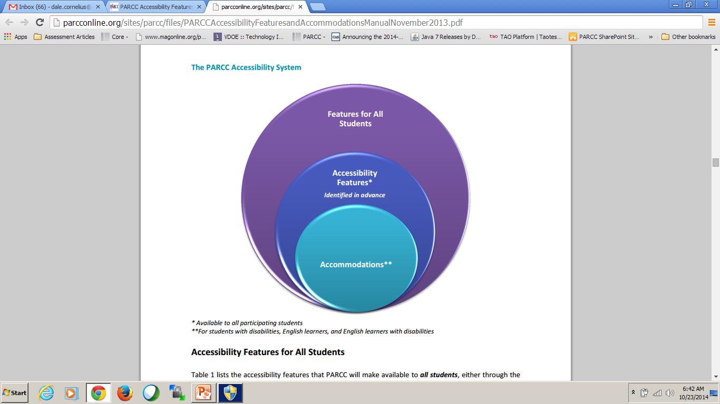
The PARCC Accessibility System

Slide 8
Accessibility Features for All Students
Support | Description | Identified in Advance by PNP
General Masking | The student creates a custom “mask” to electronically cover portions of test items, including passages, as needed. | Yes
Highlight Tool | The student highlights text as needed to recall and/or emphasize.

Slide 9
Accessibility Features for All (con’t)
Support | Description | Identified in Advance by PNP
Line Reader Tool | The students uses onscreen tool to assist in reading by raising and lowering the tool for each line of text onscreen.
Headphones or Noise Buffers | The student uses headphones or noise buffers to minimize distraction, access embeded text-to-speech.

Slide 10
Accessibility Features for All (con’t)
Support | Description | Identified in Advance by PNP
Magnification/Enlargement Device | The student enlarges text and graphics onscreen, up to 400% (while preserving clarity, contrast, and color).
NotePad | The student writes and edits notes using embedded NotePad application.

Slide 11
Accessibility Features for All (con’t)
Support | Description | Identified in Advance by PNP
Pop-up Glossary | The student is able to view definitions of pre-selected, construct-relevant words by selecting a hyperlink on screen via pop-up text box
Redirect Student to the Test (by test administrator) | The test administrator redirects the student’s attention to the test without coaching or assisting the student in any way.

Slide 12
Accessibility Features for All (con’t)
Support | Description | Identified in Advance by PNP
Spell Checker | Spell Checker The student uses spell-check software.
Text-to-Speech for the Mathematics Assessments | Text is read aloud to the student using embedded text-to-speech software. Student must be tested in a separate setting if unable to wear headphones. | Yes

Slide 13
Accommodations Options Identified in Advance (for students with IEPs, etc.)
Refreshable Braille displays
Text-to-speech
American Sign Language
Descriptive video
Closed captioning of multimedia passages
Tactile graphics
Word prediction
For more information: http://parcconline.org/sites/parcc/files/PARCCAccessibilityFeaturesandAccommodationsManualNovember2013.pdf

Slide 14
For a Complete List of Accessibility and Accommodations Features
Download the PARCC ACCESSIBILITY FEATURES AND
ACCOMMODATIONS MANUAL
http://parcconline.org/sites/parcc/files/PARCCAccessibilityFeaturesandAccommodationsManualNovember2013.pdf

Slide 15
Part II
New Item Types: Technology Enhanced Items

Slide 16
New Item Types:
Technology Enhance Items (TEIs)
Challenges | Opportunities
New Item Types: Students need to become familiar with the format of the new, online item types. | TEIs: Ability to assess deeper levels of learning and understanding as opposed to traditional multiple choice and constructed response. Unlimited opportunity.
New Tools and Functionality: Students need experience practicing online so that they become comfortable with the online tools and user interface | TEI: More engaging and interesting to most students

Slide 17
Technology Enhanced Items
Becoming Familiar With PARCC Online Question Types
Two sites to bookmark:
  practice.parcc.testnav.com
  http://parcc.pearson.com/

Slide 18
New English Language Arts Question Types and Tools
PARCC Sample Set Grades 3-5 ELA: http://practice.parcc.testnav.com/
Drag and drop
Constructed Response Editors (Microsoft Word type tools). And what is the point of the editor? Wills students get points for bolding or putting font in italics? To be determined?
Do your third graders know how to keyboard? If so, they probably learned in second grade, right?

Slide 19
New English Language Arts Question Types and Tools
PARCC Sample Set Grades 6-8 ELA: http://practice.parcc.testnav.com/
Drag and drop
Video Passages: watch a video and answer questions
Multiple Select instead of multiple choice (click all that apply)
Analyze Multiple Passages simultaneously (in past students were only asked to read and respond to one passage at a time).
Constructed Response Editors (tools like what is seen on Microsoft Word). Again, what does bolding do?

Slide 20
New Mathematics Question Types and Tools
Grade 3-5 Math Sample Items
  Link: http://practice.parcc.testnav.com/
Select numbers from an Option Box Drop Down (requires knowledge of how to use a mouse)
Enter answer in a box (requires experience with keyboarding)
Gridding (easy if you have done it before)
Completing subtraction online (the child will need scratch paper, so experience transferring answer from paper to online is needed)
Equation editor-better practice with that (being simplified)

Slide 21
MSDE is Developing Tutorials that Explain all the New Online Item Types, Features and Functionality
Check the Maryland Online Testing website for more information in the near future:
  www.marylandonlinetesting.org
Tutorials being developed for teacher and student use.
Stay tuned. Will launch in December when practice tests go live.

Slide 22
Part III
New Modes of Delivery

Slide 23
New Modes of Delivery
Challenges | Opportunities
Setting up and managing devices for testing is complex, takes time, training, and significant investments in human capital (all of which are in scarce supply). | Online high-stakes assessments will eventually give students and teachers immediate feedback (most benchmarks and diagnostic assessments online already do).
Purchasing needed devices, making needed investments in bandwidth, and hiring staff to support PARCC will be more challenging in some districts than others. | Ability to use devices used for learning to assess students (i.e., tablets and Chromebooks, PCs, Macs) is ideal because students should be familiar with the hardware.

Slide 24
PARCC Online: Modes of Delivery
Traditional PCs and Macs
Tablets: iPads, Windows, Android
Chromebooks
For more info see PARCC Technology Guidelines:
http://parcconline.org/sites/parcc/files/Technology%20Guidelines%20for%20PARCC%20Assessments%20v%204_2%20May%202014.pdf

Slide 25
Technology is the Common Thread
New Maryland College and Career Ready Standards require equal access to technology:
One Example (of many): 3rd grade Maryland College and Career Ready Standard standard for English Language Arts Literacy:
Requires that students “With guidance and support from adults, use technology to produce and publish writing (using keyboarding skills) as well as to interact and collaborate with others.”
Students should begin learning keyboarding in 2nd grade, since the PARCC assessments are computer-based, starting in 3rd grade, and students who know how to keyboard in third grade will have an easier time answering questions that require a written response.

Slide 26
So how ready are our schools to administer PARCC 100% online? For the most part, we will be ready, but there are gaps when it comes to access to digital learning.

Slide 27
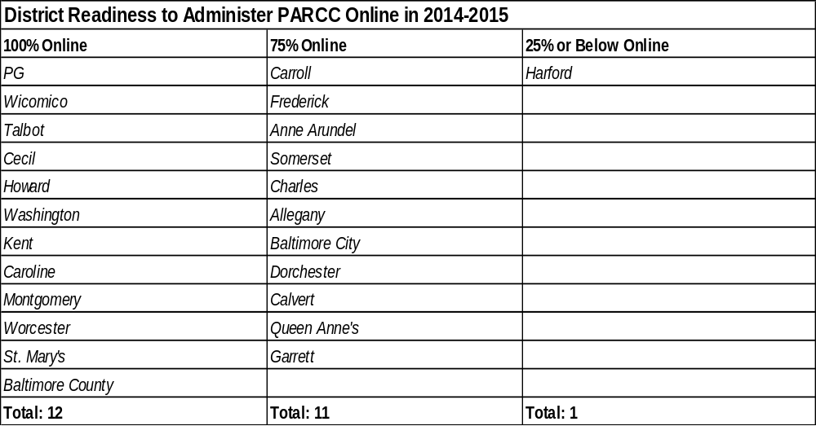
District Readiness to Administer PARCC Online in 2014-2015

Slide 28
Question
How can we create equal access to technology in the transition to digital learning and next generation, online PARCC assessments?

Slide 29
Part IV
Creating Digital Equity in Schools

Slide 30
Three Ways to Achieve Digital Equity in Schools
Create 1-1 Schools*
Build human capacity to support digital learning and online testing
Assess students 100% online
*1-1 Schools are schools that have a 1-1 student-to-device (computer) ratio

Slide 31
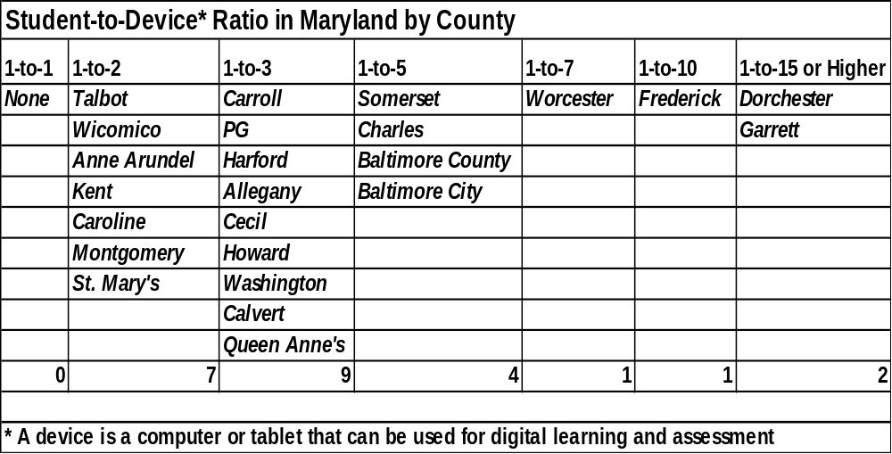
Increase Funding to Support 1-1

Slide 32
The Tipping Point: 1-1 Schools
Create more learning opportunities for students
Access limitless learning opportunities online.
Collaborate more easily with teachers and other students.
Receive more personalized instruction (for example Khan Academy)
Leverage innovative approaches to learning like “flipped classrooms”

Slide 33
Leverage Bring Your Own Device (BYOD) if Possible (it’s not easy)
Technology-If students control devices, and not school districts, nefarious activity can be done without school leaders knowing.
Policy-The creation of a BYOD program requires the development of policy for all interested parties (students, parents, teachers, administrators)
Equity-If students can not afford a personal device, the school district should provide one. Some districts may not have the ability to go BYOD because of the student population.
Funding-BYOD is not free and there are associated costs.

Slide 34
Number of BYOD Schools by County
0 Schools | 1-5 Schools | Over 20 Schools
Talbot | Charles | Carroll
PG | Cecil | Frederick
Harford | Baltimore City | Allegany
Somerset | Calvert | Howard
Wicomico |  | Montgomery
Baltimore County
Anne Arundel
Dorchester
Washington
Kent
Queen Anne's
Caroline
Garrett
Worcester
St. Mary's

Slide 35
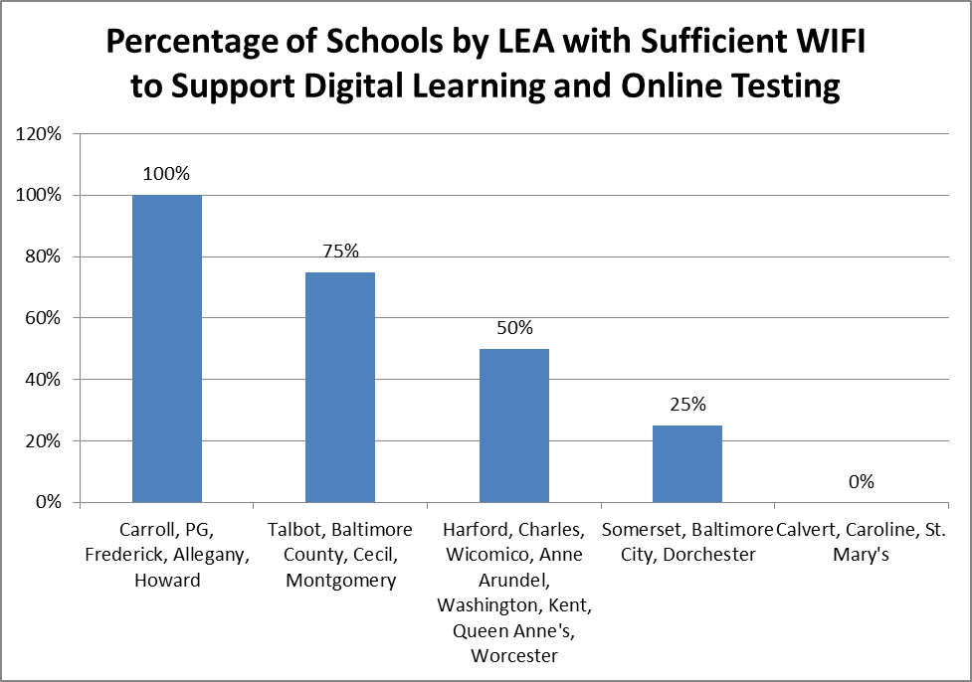
Increase Investments in WiFi

Slide 36
Build Human Capacity to Support Technology
Pay Market Rate for Highly Skilled Information Technology (IT) Professionals. It is hard to hire, and retain, skilled workers when they can make more in the private sector.
Hire a Full Time Technology Staff Member at Every School

Slide 37
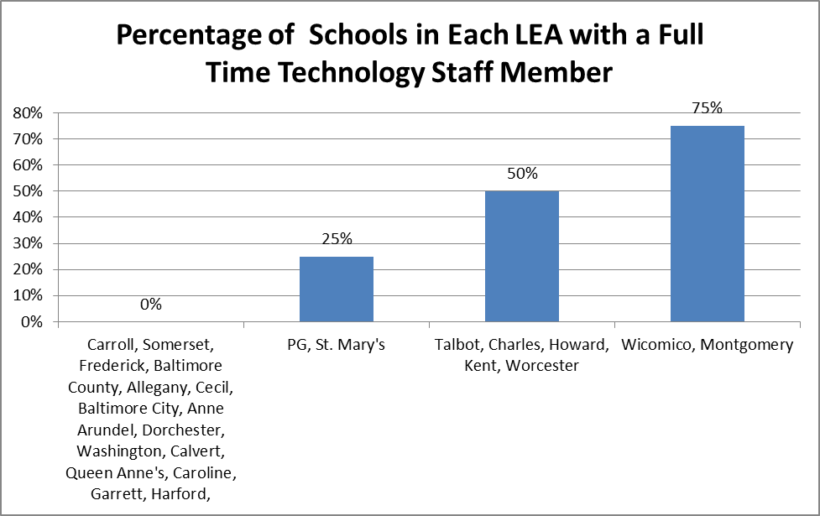
Hire a Full Time Technology Staff Member at Every School

Slide 38
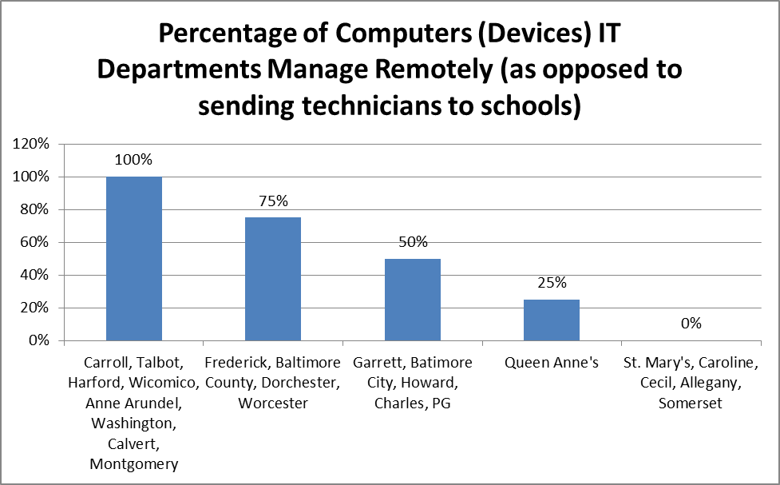
Invest in Remote Management and Monitoring

Slide 39
Change the Way Technology is Funded in Schools
Grants for technology are not helpful if they do not include support for ongoing costs.
Transitional costs do not occur in one fiscal year alone but rather over the course of the implementation period (i.e., over multiple fiscal years).
Ongoing costs always include:
Maintenance and repair
Technological obsolescence

Slide 40
Conclusion
PARCC is creating many new challenges and opportunities for schools, but we can’t forget that it is not all about assessment; rather, it is about learning, and investment in technology to support PARCC gives us the opportunity to provide greater access to digital learning and, in turn, technology equity among students.
Ask yourself, “Could I do my job without my laptop or device?” The answer is “no” and the same is true for student learning in the 21st Century.
THANK YOU!

Slide 41
Questions?
A copy of this presentation will be made available on the MAG website
Thank You

