Slide 1
The Importance of Coherent Lessons in Elementary Mathematics
Linda Schoenbrodt, MSDE, Elementary Programs Specialist
October, 2014

Slide 2
TODAY’S OUTCOME
Participants will:
Explore in depth the “shift” of COHERENCE and its impact on mathematics content, instruction, and assessment of the MD CC-R standards .

Slide 3
Getting on Track with PARCC
Provide daily instruction for students to learn the mathematics content based on MD College and Career- Ready Standards and using the progressions
Develop the behaviors students need to demonstrate their knowledge and understanding of the content- Think and act like mathematicians.

Slide 4
CCSS Shifts for Mathematics
Focus: strongly teach the content focus of the standards using the mathematical progressions
Coherence: think across grades, and link to major topics within each grade.
Rigor: in major topics, pursue with equal intensity
  Conceptual Understanding
  Procedural Skill and fluency
  Applications

Slide 5
PARCC talks about the CCSS Shifts for Mathematics
“Two major evidence based principles, on which the standards are based, are focus and coherence.
Focus is necessary so that students have time to think, practice, and integrate new ideas into their growing knowledge structure.”.(PARCC-Framework. Grades 3-11)

Slide 6
PARCC- Coherence- Across Grades
Some standards knit topics that are at a single grade
Most topics, play out across two or more grades to form a progression of increasing knowledge, skill, or sophistication.”
Instruction at any given grade would benefit from being informed by the overall progression across grades.
From PARCC Frameworks, Grades 3-11

Slide 7
Coherence: Think Across Grades, and Link to Major Topics Within Grades
Carefully connect the learning within and across grades so that students can build new understanding on foundations built in previous years.
Begin with solid conceptual understanding of core content and build on it. Each standard is not a new event, but an extension of previous learning.

Slide 8
Coherence: Think Across Grades
Example: Fractions
“The coherence and sequential nature of mathematics dictate the foundational skills that are necessary for the learning of algebra.
The most important foundational skill not presently developed appears to be proficiency with fractions (including decimals, per cents, and negative fractions)”
The teaching of fractions must be acknowledged as critically important and improved before an increase in student achievement in algebra can be expected.”
Final Report of the National Mathematics Advisory Panel (2008),

Slide 9
Fractions Domain
First, read through the document, Number and Operations- Fractions, grades 3-5.
Second read
  Circle Verbs

Slide 10
Language of the Standards
Conceptual Understanding
Procedural Skill
  Understand
  Interpret
  Recognize
  Describe
  Explain
  Fluently
  Compute
  Convert
  Solve
Modeling/Application
  Use math flexibly
  Problem solving context
  Real world problems

Slide 11
Fractions Domain
First, read through the document, Number and Operations- Fractions, grades 3-5.
Second read
  Circle Verbs
  Pay attention to the focus and coherence. Identify recurring themes, threads of learning.(label those A, B, etc)
  *Any Important sections that stand out for you.
Talk with the person near you to share your observations

Slide 12
Grade-To-Grade Coherence
Grades 1 and 2
  Partition shapes (circles and rectangles
  Describe the shares using words halves, fourths, quarters
Grade 3 :
  Fractions as a Number- Unit Fractions
  Representing Fractions on a Number Line
  Equivalent Fractions
  Comparing Fractions
Grade 4
Equivalent Fractions-unit fractions
Comparing Fractions-unit fraction
Adding and Subtracting like fractions (unit fractions)
Multiplying a fraction by a whole number (unit fractions)
Decimals
Grade 5
Adding and Subtracting Fractions
Multiplying and Dividing Fractions
Multiplying as Scaling

Slide 13
Recurring Threads
Unit fractions
Representing fractions on the number line
Importance of identifying the whole
Describing the parts of the whole
Notes:
Before we move on- there is another type of coherence that is essential for not only teaching and learning the content, but also for developing those behaviors of a mathematician.
CLICK)Activity 3- Grade-To-Grade Coherence
Explain, this slide shows a summary of the some topics that thread through each grade as content changes.. These topics thread within and between the standards. These are enduring understandings of fraction standards. As you go through the standards note these topics constant between the grades.

Slide 14
Coherence-Between the Content and Practice Standards
Rigorous mathematical instruction and learning occur when content and the practices are joined together.
SMP- Describe the attributes of mathematically proficient students and support the foundations of learning mathematics.

Slide 15
Standards of Mathematical Practice
Reasoning and Explaining
  2. Reason abstractly and quantitatively
  3.Construct viable arguments and critique the reasoning of others
Modeling and Using Tools
  4.Model with mathematics
  5. Use appropriate tools strategically.
Seeing Structure and Generalizing
  7. Look for and make use of structure
  8. Look for and express regularity in repeated reasoning.
Overarching Habits of the Mind
  1.Make sense of problems and persevere in solving them.
  5. Attend to precision.

Slide 16
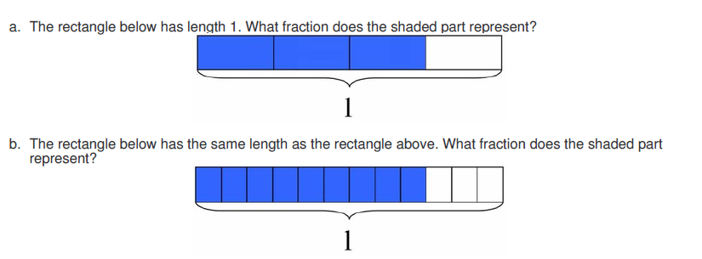
Explaining Fraction Equivalence with Pictures
Notes:
.

Slide 17
Grade- To- Grade Coherence
Reflection and Discussion
How is coherence a part of the content for this task?
What behaviors do students need to demonstrate to solve this task?
What are the implications for instruction for teachers/students?
How is understanding grade-to- grade coherence helpful for planning and teaching daily lessons ?

Slide 18
Grade-To-Grade Coherence
Grades 1 and 2
  Partition shapes (circles and rectangles
  Describe the shares using words halves, fourths, quarters
Grade 3 :
  Fractions as a Number- Unit Fractions
  Representing Fractions on a Number Line
  Equivalent Fractions
  Comparing Fractions
Grade 4
Equivalent Fractions-unit fractions
Comparing Fractions-unit fraction
Adding and Subtracting like fractions (unit fractions)
Multiplying a fraction by a whole number (unit fractions)
Decimals
Grade 5
Adding and Subtracting Fractions
Multiplying and Dividing Fractions
Multiplying as Scaling

Slide 19
Standards of Mathematical Practice
Reasoning and Explaining
  2. Reason abstractly and quantitatively
  3.Construct viable arguments and critique the reasoning of others
Modeling and Using Tools
  4.Model with mathematics
  5. Use appropriate tools strategically.
Seeing Structure and Generalizing
  7. Look for and make use of structure
  8. Look for and express regularity in repeated reasoning.
Overarching Habits of the Mind
  1.Make sense of problems and persevere in solving them.
  5. Attend to precision.

Slide 20
Grade 4 | from Domain to Domain
OA.A | Use the four operations with whole numbers to solve problems
NF.A | Build fractions from unit fractions by applying and extending previous understanding of operations of whole numbers. Extend the understanding of fraction equivalence and ordering Explain why a fraction a/b is equivalent to a fraction (n x a)/(n x b) by using visual fraction models…
MD.A | Solve problems involving measurement and conversions of measurement from a larger to smaller unit. (use four operations to solve problems including problems involving fractions and decimals

Slide 21
Mrs. Russell’s Problem
“Mrs. Russell wants to have ribbons on each corner of her garden identifying the various crops.
She determined 2/3 of a yard was the perfect length for each ribbon.
Since ribbon is sold by the yard, how much should be purchased for all four corners ?”
Create a representation to justify your thinking.
Teacher Amy Spies Voulusia County, FL The Teaching Channel Lesson

Slide 22
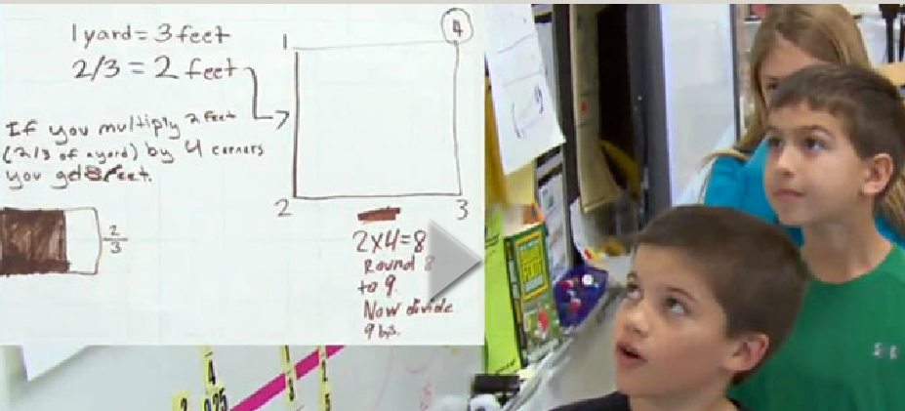
Within-Grade Coherence
https://www.teachingchannel.org/videos/
multiplying-fractions-by
-whole-numbers-lesson

Slide 23
Within-Grade Coherence
Watch the video “Multiplying Fractions By Whole Numbers”.
Use the note taking form to record evidence of within-grade coherence and any between grade coherence.
Reflect- What do you notice about this lessons’ reliance on COHERENCE?

Slide 24
Group Discussion
What concepts from previous grades did students need to know to be successful with this task?
What on-grade level standards did students need to know?
Which SMP were evident?
What are the implications for instruction?

Slide 25
Standards of Mathematical Practice
Reasoning and Explaining
  2. Reason abstractly and quantitatively
  3.Construct viable arguments and critique the reasoning of others
Modeling and Using Tools
  4.Model with mathematics
  5. Use appropriate tools strategically.
Seeing Structure and Generalizing
  7. Look for and make use of structure
  8. Look for and express regularity in repeated reasoning.
Overarching Habits of the Mind
  1.Make sense of problems and persevere in solving them.
  5. Attend to precision.

Slide 26
Coherence In Assessment
Evidence of Coherence in assessment is not tremendously different from evidence of coherence in classroom instruction.

Slide 27
PARCC Items
Solve problems involving the Major work of the grade with connections to the practice standards;
Solve problems involving the Additional and Supporting work of the grade with connections to the practice standards;
Express mathematical reasoning by constructing mathematical arguments and critiques;
Solve real-world problems by engaging particularly in the modeling practice; and
Demonstrate fluency in the areas set for in the content standards for Grades 3 – 6

Slide 28
Task Types
Type I- assesses concepts, skills, and procedures. Tasks are a balance of all three parts of rigor and any of the math practice.
Type II- assesses expressing mathematical reasoning. Tasks call for written arguments/justifications, critique of reasoning or precision in mathematical statements.
Type III- assesses modeling/application in real world context or scenario and can also involve other mathematical practice standards.

Slide 29
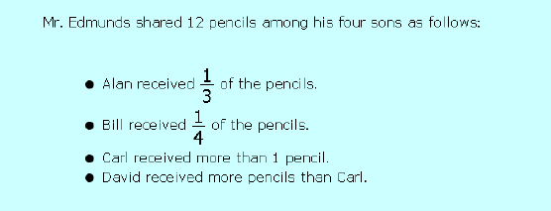
COHERENCE- PARCC ASSESSMENT
Mr. Edmund’s Pencil Box

Slide 30
PARCC - Reflect and Discuss
What evidence of coherence did you find?
    Grade to Grade Coherence
    Within Grade Coherence
Which Standards for Mathematical Practice are assessed in this task?
What does this mean for instruction in your classroom?

Slide 31
Getting on Track with PARCC
Provide daily instruction for students to learn the mathematics content based on MD College and Career- Ready Standards and using the progressions
Develop the behaviors students need to demonstrate their knowledge and understanding of the content- Think and act like mathematicians.

