Slide 1



Tools for Instruction and Assessment for the Maryland College- and Career-Ready Standards
Time to Revisit Tools that will Inform Instruction

Slide 2

Outcomes
Participants will review tools that have been developed and released over the last several years.
Participants, based on their current roles will consider how these tools and assessments can be used to advance student achievement.

Slide 3
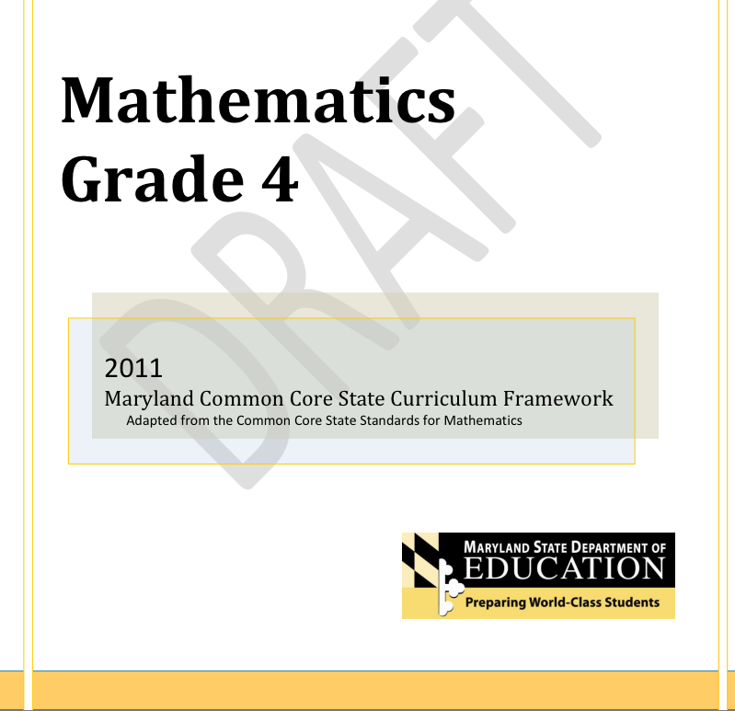
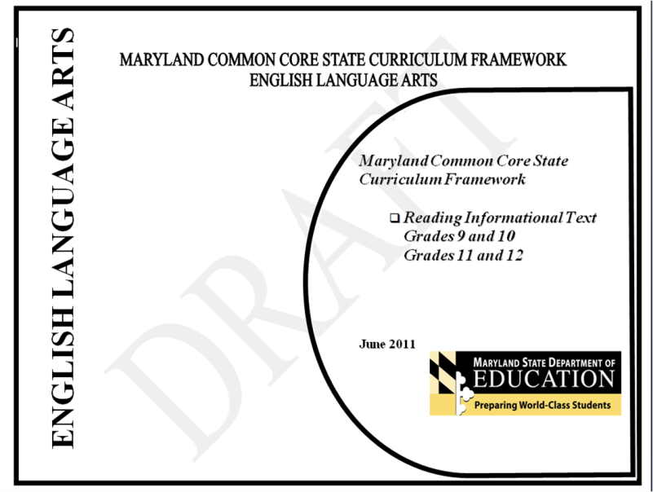
MSDE College- and Career- Ready Curriculum Frameworks
http://www.mdk12.org/instruction/commoncore/index.html

Slide 4
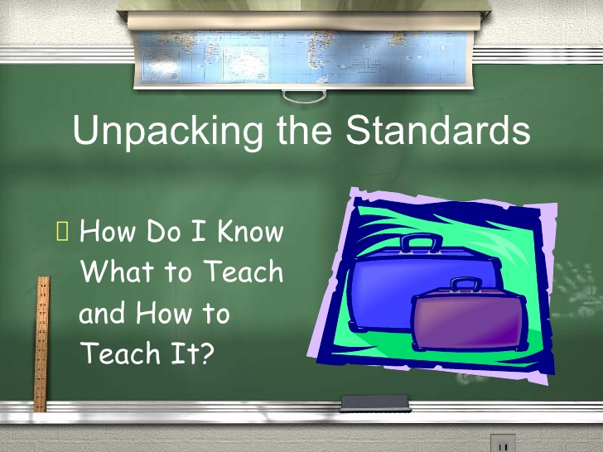
Purpose of MSDE Frameworks
Analyze the Standards into their Essential Skills and Knowledge
Assist teachers with individualizing student instruction
Assist curriculum writers with scaffolding units and lessons

Slide 5

Take a Look
Take 10 minutes to look at one of the MSDE Curriculum Frameworks
Discuss with a partner (or two) or two how this might be used in your role.
Be prepared to share your discussion

Slide 6
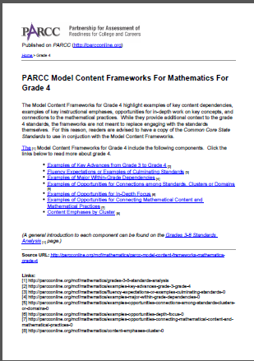
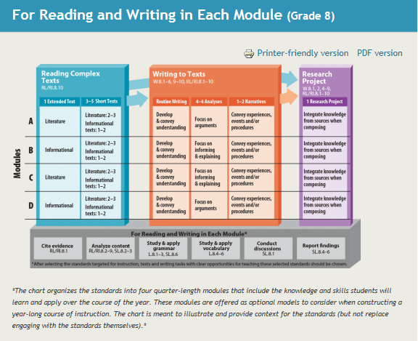
PARCC Model Content Frameworks
http://www.parcconline.org/parcc-model-content-frameworks

Slide 7
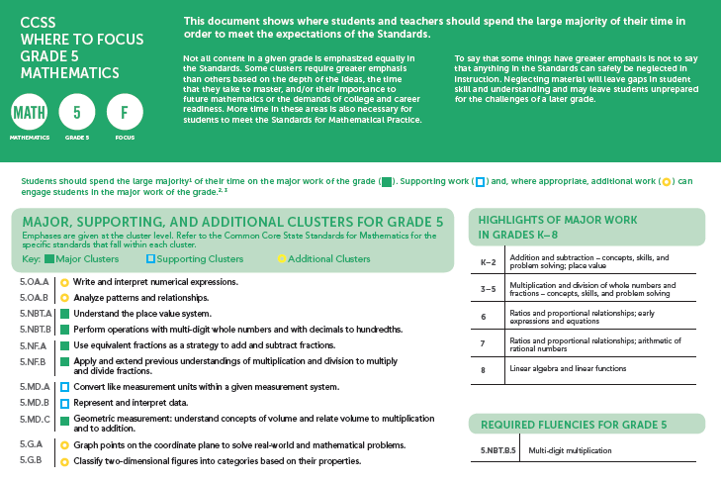
In addition to math content frameworks…..

Slide 8
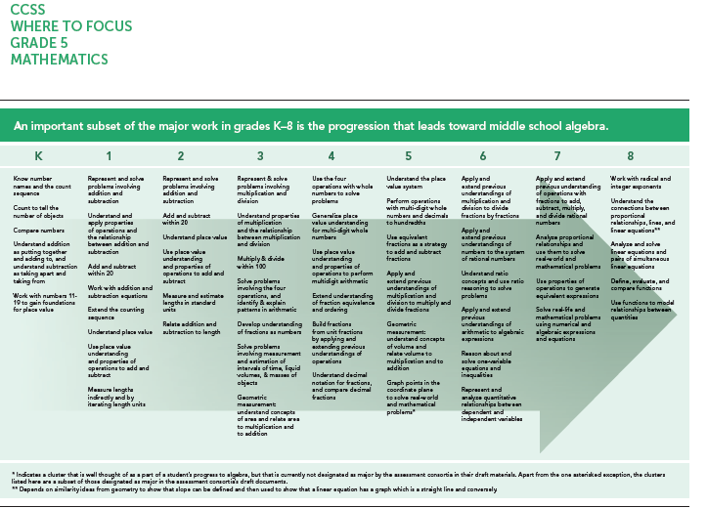
http://achievethecore.org/dashboard/300/search/1/2/0/1/2/3/4/5/6/7/8/9/10/11/12/page/774/focus-by-grade-level-list-pg

Slide 9

Purposes of Content Framework*
Bridge between Common Core Standards and the PARCC assessments
Insight into Standards
Implementation of Standards
Inform development of item specifications and blueprints for PARCC assessments
* From PARCC Content Framework document

Slide 10
Take a Look
Take 10 minutes to look at one of the sample frameworks provided – math or ELA
Choose two sections that you believe would be most helpful for informing classroom instruction.
Discuss your choices with a partner (or two)
Be prepared to share your discussion

Slide 11

Student Achievement Partners
Instructional Practice Guides
ELA – grades K-2; 3-5; 6 -12
Math – grades K – 8; high school
Literacy, History/Social Studies – grades 6 – 12
Literacy, Science/Technical Subjects -
grades 6 - 12

Slide 12
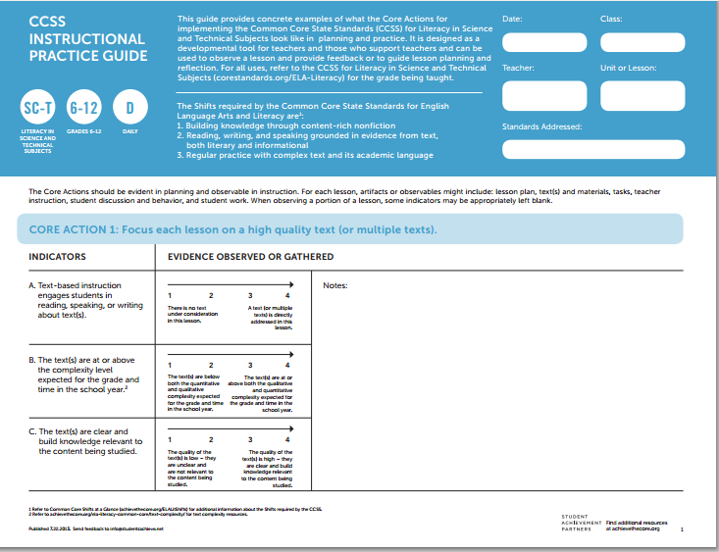

Slide 13
Purpose of the Practice Guides
This guide provides concrete examples of what the Core Actions for implementing the Common Core State Standards (CCSS) [for ELA, Mathematics, Literacy] look like in planning and practice. It is designed as a developmental tool for teachers and those who support teachers and can be used to observe a lesson and provide feedback or to guide lesson planning and reflection. For all uses, refer to the CCSS for Literacy in Science and Technical
Subjects (corestandards.org/ELA-Literacy) for the grade being taught.

Slide 14
Core Actions and Shifts
Core actions align with instructional shifts
Each action includes indicators
For each indicator, opportunity to gather/observe for evidence of the indicator
http://achievethecore.org/page/969/instructional-practice-guide-list-pg

Slide 15
Take a Look
Take 10 minutes to look at one of the sample practice guides
Discuss with a partner (or two) how this might be used in your role.
Be prepared to share your discussion

Slide 16

Powerful Tools!
  PARCC Content Frameworks
  Instructional Practice Guides
  MSDE Curriculum Frameworks

Slide 17

Speed Dating!
  Follow the directions on the handout to identify the most important way you can use each of these tools in your role.
  Then let’s Speed Date!

Slide 18
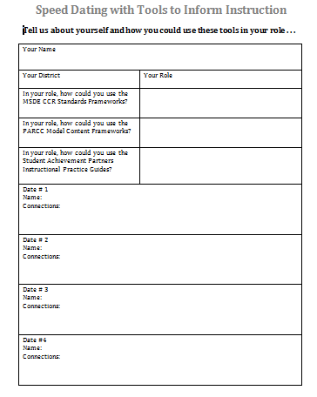

Slide 19
Wrap-Up and Sharing
Based on the conversations you have had, be prepared to share your favorite idea for using some or all of the tools reviewed today.

Slide 20

Contact Information
Judy Jenkins
Judith.Jenkins@Maryland.gov
Cecilia Roe
Cecilia.Roe@Maryland.gov

